Slide 1

SPAAR news to know and things to do
SPAAR members have a full calendar of news and events to choose from, including these highlights:
September 14: Poured with Purpose member event.
September 24: Housing Resource Fair for members, clients and community.
September 8-16: MAR and SPAAR member information sessions.
September 29-October 2: Member vote to merge SPAAR and MAR.
November 16-20: Lockbox exchange to SentriLock

Slide 2

Learn more about the SentriLock conversion.
Electronic lockboxes are a critical tool for agents to deliver a more professional, secure and seamless experience for everyone involved.
After thorough, member-informed evaluation process, Minneapolis Area Realtors® and the Saint Paul Area Association of Realtors® are excited to share that our boards of directors selected SentriLock as our new electronic lockbox provider beginning in Fall 2026. This decision reflects the feedback collected from hundreds of members over a months-long vetting process. Thanks to all who participated to guide this decision.
A technology transition and lockbox exchange will take place in November 16-20. Check back for more details in the coming weeks or watch the newsletter as details will be communicated there once they are known.

Slide 3

SPAAR and MAR recommended merger:
Charting the Future, Together
The Boards of Directors of both SPAAR and MAR have unanimously voted to recommend a merger of the two associations. A member vote will take place September 29 through October 2 and, if approved, the merger would be effective January 1, 2027. Learn more about the merger.
SPAAR and MAR believe this is a unique time and opportunity to create one association that maximizes the two associations’ different strengths and unique histories to carry the mission even further for the collective 16,000 members.
Click on the graphic below to hear about the merger from Board members.

Slide 4

Take part in an upcoming information session.
Register via SPAAR’s calendar.

Slide 5


The countdown is on! And all members are welcome!
Take part in this year’s Poured with Purpose to mingle with other members and grow your business network over delicious heavy hors d’oeuvres at 7 Vines Vineyard & Winery in Dellwood to support REALTORS® Charitable Foundation and its meaningful work giving back to members and the larger community.
Poured with Purpose is Monday, September 14, and space remains for members to join in this fun experience in the beautiful vineyard setting to sip, savor, connect and give back. Enjoy curated wine experiences, guided wine tours, heavy hors d’oeuvres and desserts, an exciting silent auction and plenty of opportunities to connect with colleagues and friends.
Tickets are $100 per person so register for Poured with Purpose today! Raise a glass, enjoy the experience and help make a difference in the community.

Slide 6
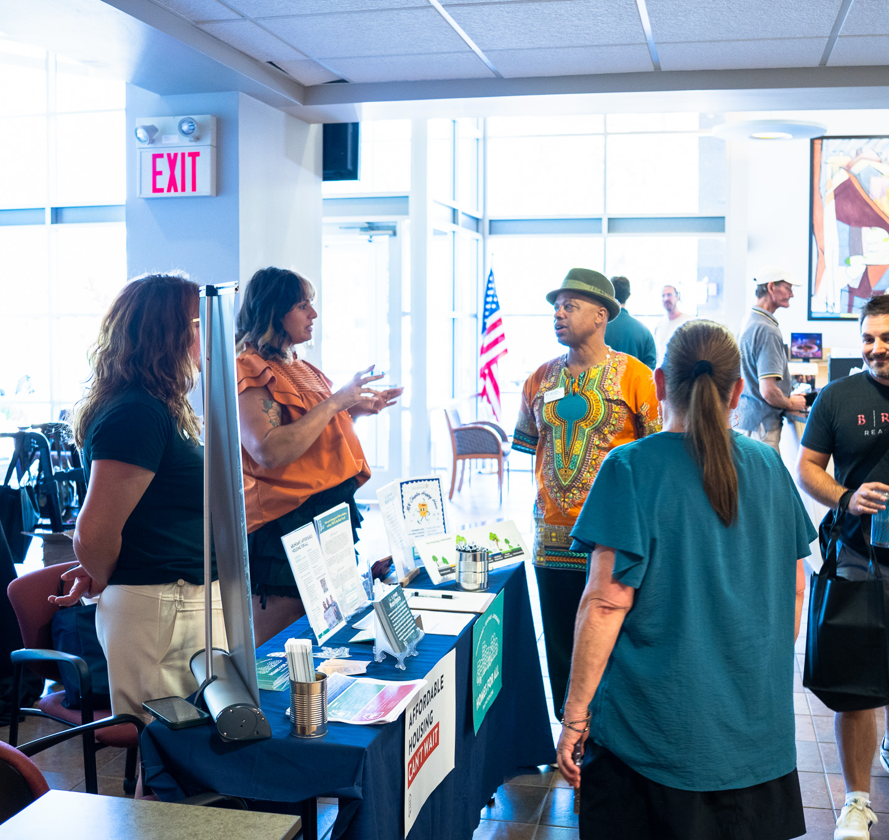
SPAAR’s Housing Resource Fair is September 24: excellent resources, new time and new location!
This event is a great opportunity for Realtors®, clients and the general public to learn about the abundance of homeowner and housing resources available in the Twin Cities as provided by local and county governments and community nonprofits.
Thursday, September 24 from 4-6pm
International Institute of MN
1694 Como Ave, Saint Paul, MN 55108

Slide 7
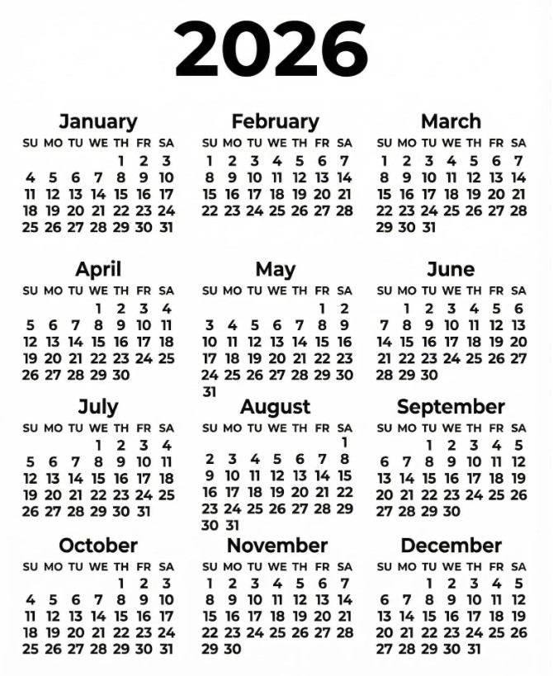
Take advantage of classes and events at SPAAR!
Check out SPAAR’s calendar to stay up to date on classes, events and more throughout 2026.
In addition to what’s offered online and in person per SPAAR’s calendar, SPAAR also offers a microlearning library with a variety of topics that cover tips, tricks and tutorials, all available to watch on video.
Email spaar@spaar.com with questions.

Slide 8



Click here to see the latest Twin Cities housing statistics
(also available on SPAAR’s website under News & Statistics).

Slide 9



Are you receiving SPAAR’s weekly newsletters?
If not, email spaar@spaar.com
to be sure you’re receiving
eNews on Mondays and Education updates on Thursdays.
Keep up to date on SPAAR information and events at www.spaar.com and on social media: Facebook, Instagram, Twitter and LinkedIn.

