Slide 1
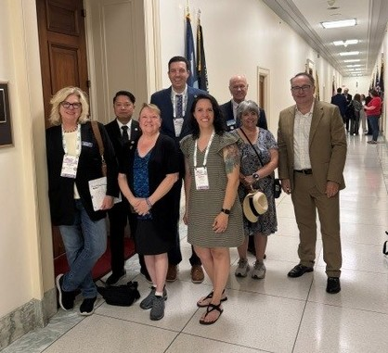
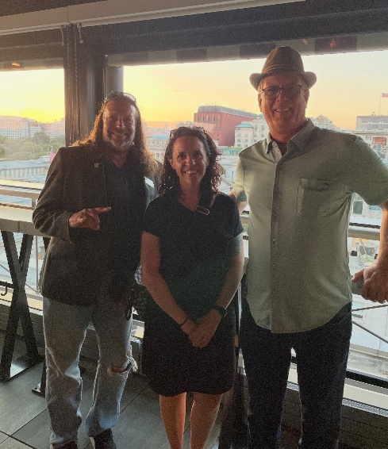
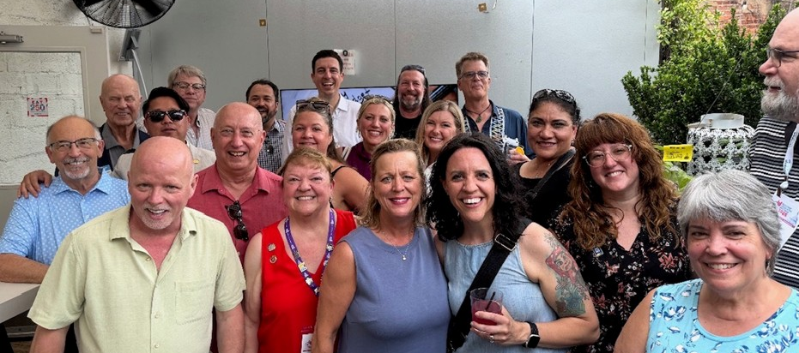
SPAAR members represented in Washington DC at Legislative Meetings
The REALTORS® Legislative Meetings took place June 13-18 in Washington, DC, and brought together thousands of members to conduct the business of NAR and unite for a common cause to advance the real estate profession through powerful, impactful policy advocacy.
Among the thousands were SPAAR members who participated in daily meetings and town hall sessions, learned firsthand about residential issues and met with elected officials, to name a few of the opportunities.

Slide 2
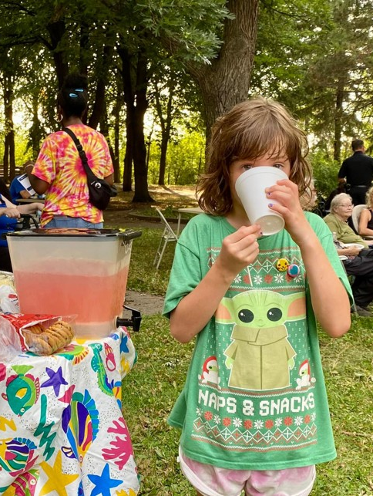
August 4 is National Night Out!
Planning a National Night Out event in your neighborhood? Hot dogs? Root beer floats? SPAAR can help!
SPAAR’s Community Engagement Committee is providing $50 Cub Foods gift cards (on a first come, first serve basis) to SPAAR members who coordinate events in their neighborhoods.
A limited number of cards are available. Email spaar@spaar.com with the subject line NNO Cub Foods gift card to claim one.
The gift cards are limited to SPAAR Realtor® and Affiliate members while supplies last.
The Cub Foods gift cards will be available for pick up at the annual SPAAR-B-Q lunch event taking place on July 21 from 11am to 1pm.

Slide 3
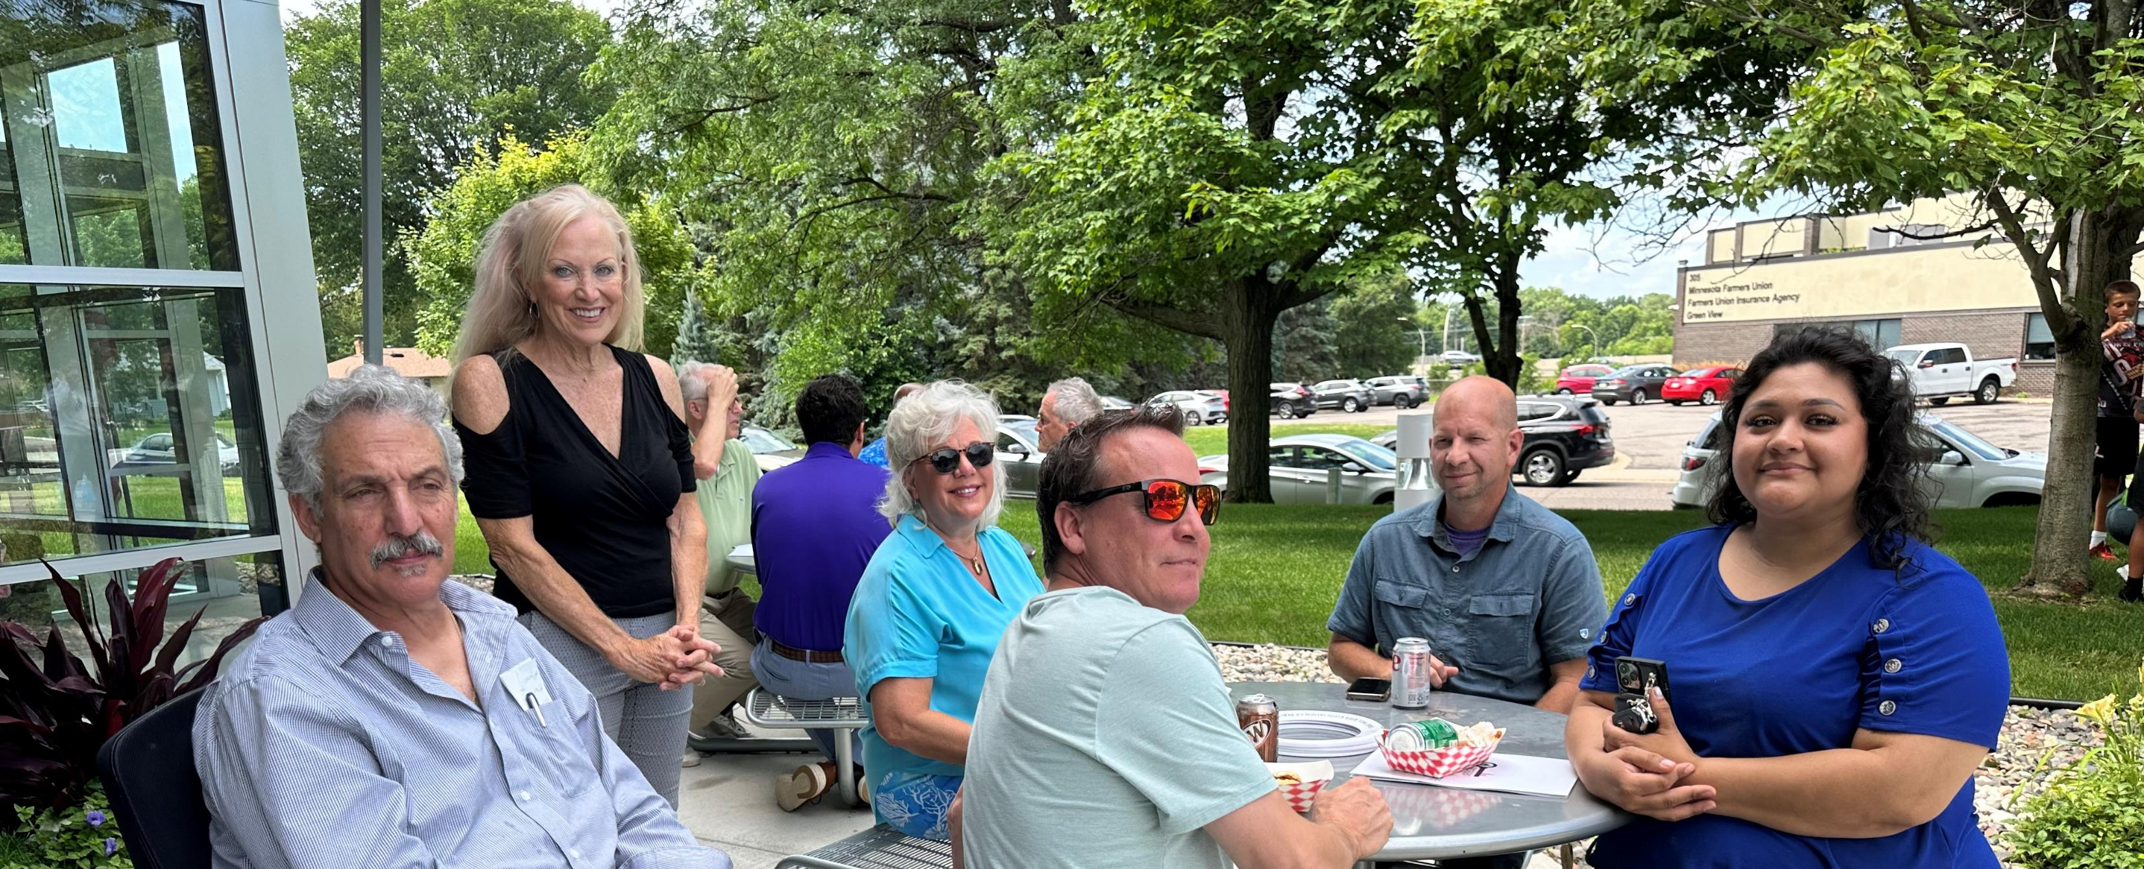
The annual SPAAR-B-Q is back!
SPAAR’s ultimate summer networking cookout, the SPAAR-B-Q, is a fun, casual event where members can connect, mingle and enjoy hamburgers and hot dogs with industry peers in a relaxed setting.
This year’s SPAAR-B-Q event will take place on Tuesday, July 21, 2026, from 11am to 1pm at SPAAR (325 Roselawn Ave. East). Registration for the SPAAR-B-Q is now open.
The event is hosted by SPAAR’s Affiliate Committee.

Slide 4
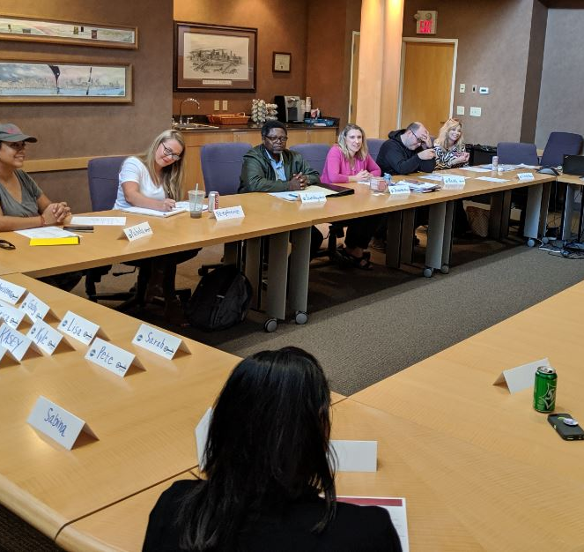
Build confidence in speaking at SPAAR Toastmasters meetings
Attend the meeting on July 21!
Come for the SPAAR-B-Q at 11am and stay for SPAAR Toastmasters at 1pm!
SPAAR welcomes Realtor® and Affiliate members who want to improve their presentation and speaking skills to attend an upcoming meeting on July 21 and hear a Pathways speech on how to get started. No prior experience is needed to attend.
What to expect? Toastmasters provides:
Communication, leadership and meeting management skills development
Impromptu speaking opportunities
Self-paced program
Constructive evaluation
Support from club members
Positive and fun learning environment
Email Jennifer @jkovacich@spaar.com with any questions.

Slide 5
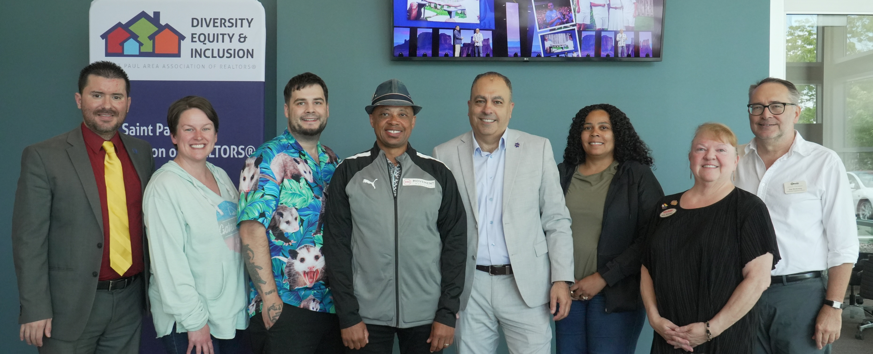
Scholarships available for Special Needs Specialist Certification
Realtor® Tony Farah presented to SPAAR’s Committee for Diversity, Equity and Inclusion about his personal experience as parent of a child with special needs. Tony developed Special Needs Specialist (SNS) Certification to share insights and educate other Realtors® who, in turn, can educate others.
Special needs can mean many things. Special needs is a term that applies to any individual who requires specific accommodation, individualized care or specialized services due to physical, mental, psychological or learning disabilities. Realtors® have opportunities to provide individualized attention to prepare families for their house hunt and educate individuals with special needs about what to expect when they market their home for sale.
SPAAR is offering reimbursement scholarships for members who complete SNS Certification. The scholarships are sponsored by SPAAR’s Committee for Diversity, Equity and Inclusion. For more information about this opportunity, email spaar@spaar.com and include “SNS Certification” in the subject line.

Slide 6
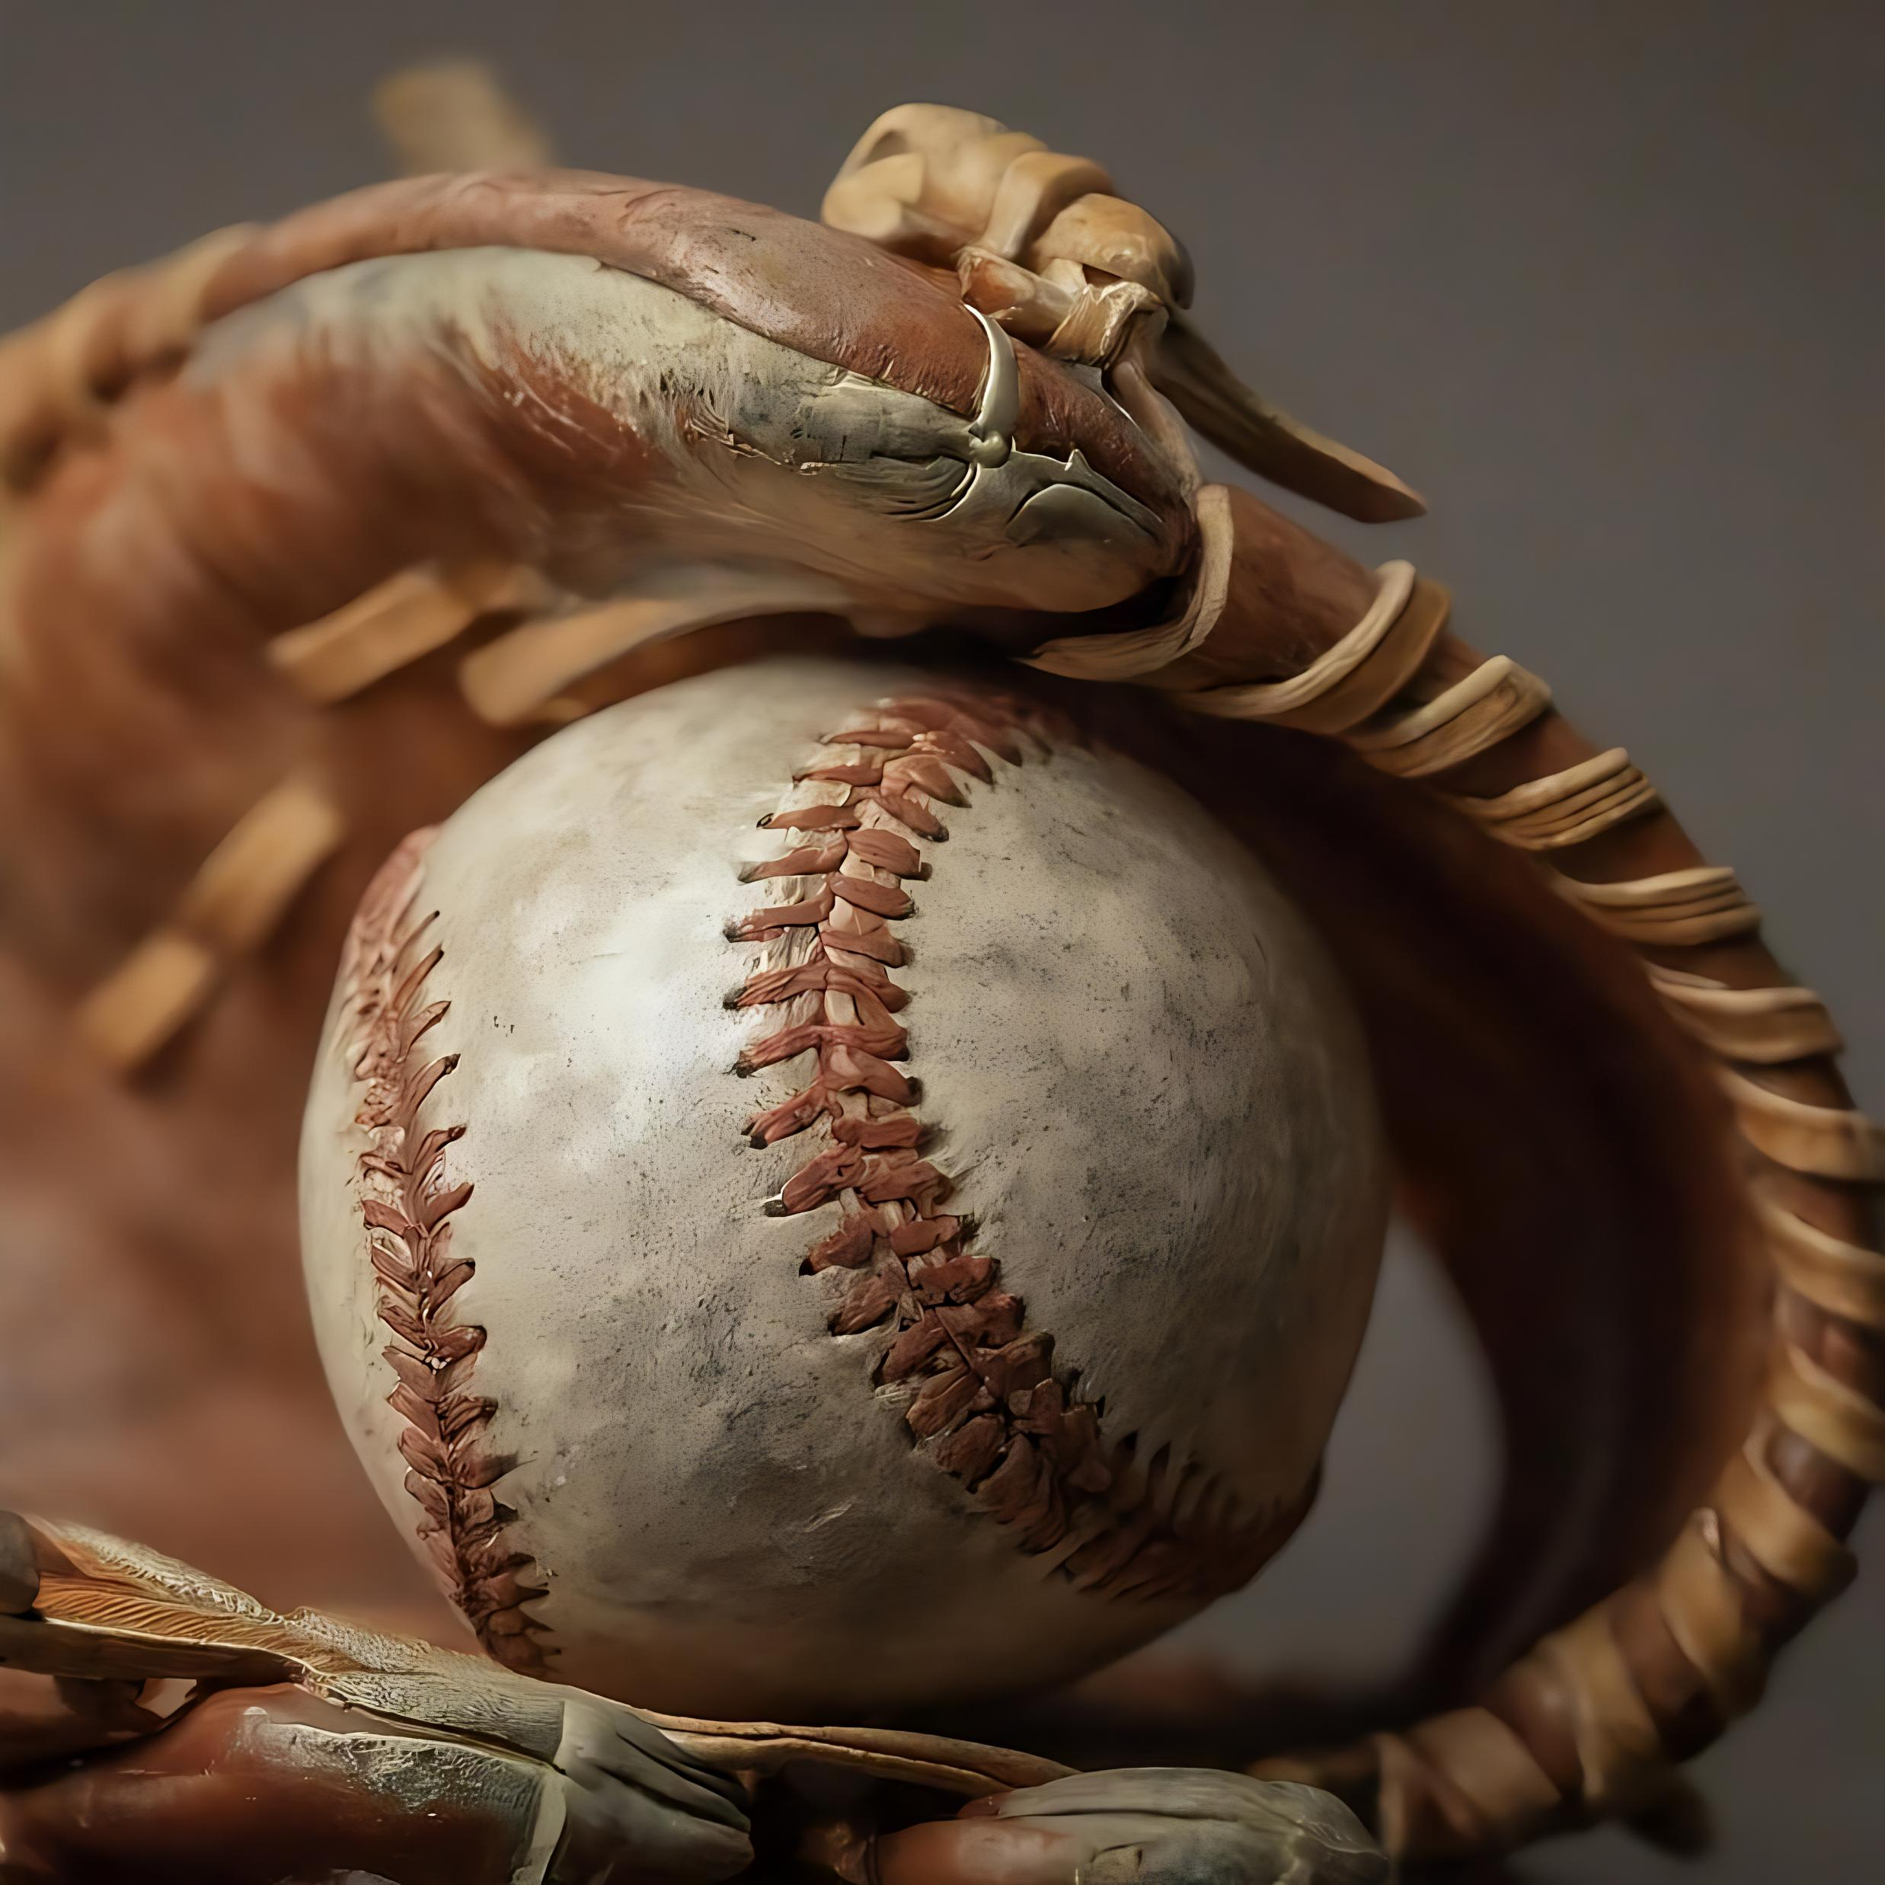
Take part in a home-run evening with SPAAR and the Saint Paul Saints
Step up to the plate with SPAAR’s Metro YPN Committee for an unforgettable night of baseball, networking and giving back on Thursday, July 23, for an exclusive VIP experience at CHS Field, home of the Saint Paul Saints. Cost is $25/person until tickets are sold out.
Arrive early for a pre-game happy hour on SPAAR before first pitch at 7:07pm. Alcoholic beverages will be available for purchase. Participate in the Grand Slam Passport Challenge for a chance to win a $150 gift card to the Saint Paul Saints Team Store! Event proceeds will benefit REALTORS® Charitable Foundation.
Come cheer on the Saints, root for home runs and make a difference together! Register here for the Saint Paul Saints game.

Slide 7
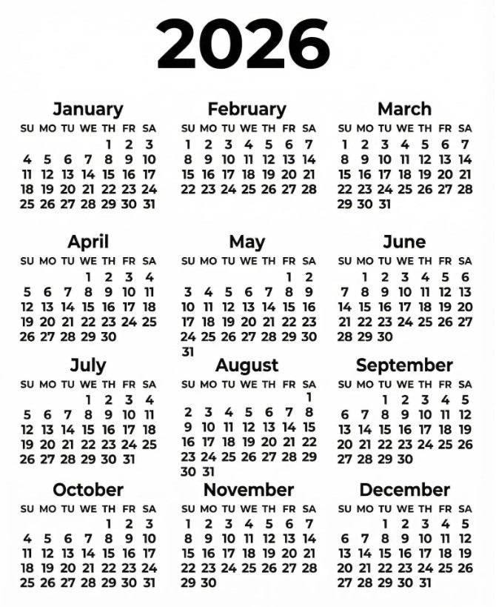
Take advantage of classes and events at SPAAR!
Check out SPAAR’s calendar to stay up to date on classes, events and more throughout 2026.
In addition to what’s offered online and in person per SPAAR’s calendar, SPAAR also offers a microlearning library with a variety of topics that cover tips, tricks and tutorials, all available to watch on video.
Email spaar@spaar.com with questions.

Slide 8


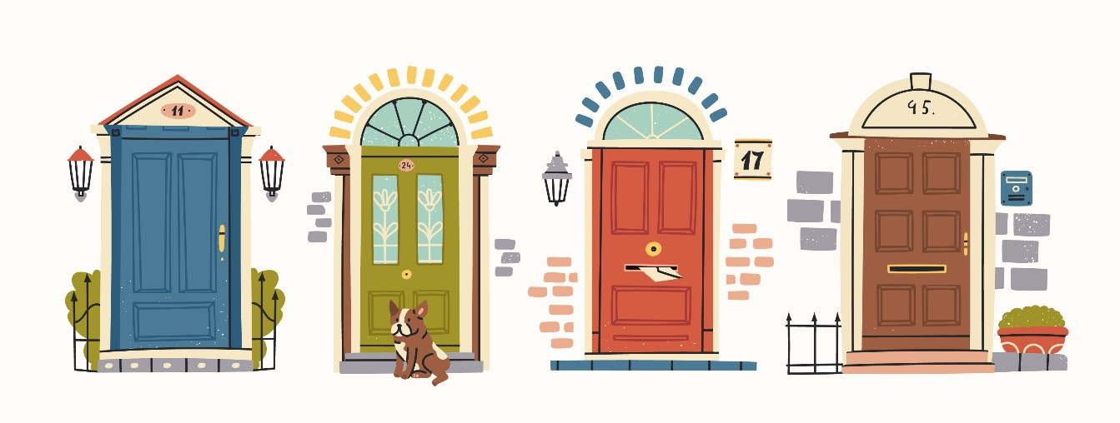
Click here to see the latest Twin Cities housing statistics
(also available on SPAAR’s website under News & Statistics).

Slide 9



Are you receiving SPAAR’s weekly newsletters?
If not, email spaar@spaar.com
to be sure you’re receiving
eNews on Mondays and Education updates on Thursdays.
Keep up to date on SPAAR information and events at www.spaar.com and on social media: Facebook, Instagram, Twitter and LinkedIn.

