Slide 1

Say “Cheese” and say “Cheers” at SPAAR’s Headshots & Hops event
Join SPAAR for Headshots & Hops, a networking event on May 6 where members will connect with industry colleagues and get a free, high-quality headshot. YPN member Borna with Square Feet Floor Plans will be on-site capturing polished, professional headshots so members can walk away with an updated look for LinkedIn or their business website.
In between photos, grab a drink, spark new conversations and network in a fun, welcoming atmosphere. Register here.

Slide 2

Realtor® roundtable member opportunity on May 12
SPAAR is seeking members willing to provide input about West Saint Paul or South Saint Paul to elected leaders and city staff who are interested in hearing from Realtors® about their experiences. They’re interested to know how to make their communities even better places to live by asking: What works well? What doesn’t? What is attractive or unattractive about each city? This Realtor® Roundtable event is on Tuesday, May 12, from Noon–1pm at the Wentworth Library in West Saint Paul. Lunch will be provided. To RSVP, email SPAAR Government Affairs Director Simon Opatz at sopatz@spaar.com.

Slide 3

Learn social media tips and skills from experts who use it well and wisely in their real estate business
Social media is ever evolving. Realtors® who do social media well and on various platforms will lead an expert panel on Wednesday, May 13, to share about their successes, insights and the strategies and tactics that have worked for them in their real estate business.
Register here to attend and ask questions of panel participants Bryan Clapper, Liz Gust and Cory Malveaux; the session will be moderated by Ben Smith.
In-person attendees will have the opportunity to create their own Instagram reel at the event!

Slide 4

MN RRC to host CEO panel discussion
Real estate in Minnesota is evolving quickly. Join the Minnesota Residential Real Estate Council for a rare leadership conversation featuring the CEOs of:
Minneapolis Area REALTORS® - Carrie Chang
St. Paul Area Association of REALTORS® - Gabe Walsh
Minnesota Realtors® - Josh McFall
This moderated panel will provide Realtors® with direct insight from the leaders closest to policy decisions, industry trends and the challenges shaping our profession. Register here.

Slide 5

SPAAR’s monthly Learning Labs are a great way to gain knowledge
SPAAR’s monthly Learning Labs and Workshops are scheduled on a variety of topics to help new and experienced members grow their knowledge and business success:
May 12 - Building a CMA
June 16 - Google Business Profiles
August - TransactionDesk Templates (date TBD)
September 16 - Intro to Canva
Check out SPAAR’s calendar to register for a course.

Slide 6
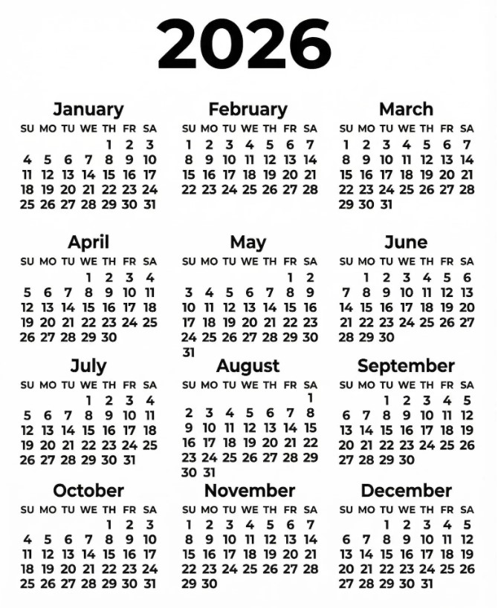
Take advantage of classes and events at SPAAR!
Check out SPAAR’s calendar to stay up to date on classes, events and more throughout 2026.
In addition to what’s offered online and in person per SPAAR’s calendar, SPAAR also offers a microlearning library with a variety of topics that cover tips, tricks and tutorials, all available to watch on video.
Email spaar@spaar.com with questions.

Slide 7

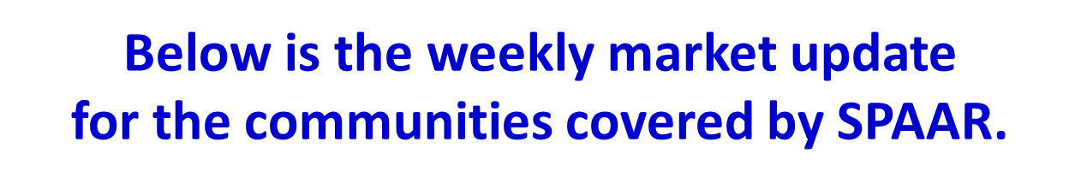

Click here to see the latest Twin Cities housing statistics
(also available on SPAAR’s website under News & Statistics).

Slide 8



Are you receiving SPAAR’s weekly newsletters?
If not, email spaar@spaar.com
to be sure you’re receiving
eNews on Mondays and Education updates on Thursdays.
Keep up to date on SPAAR information and events at www.spaar.com and on social media: Facebook, Instagram, Twitter and LinkedIn.

