Slide 1

A password change…
Yes, it’s legit!
SPAAR is requiring a password change to its member portal.
SPAAR portal users recently received an email as someone who has previously used SPAAR’s portal for membership, education or event signup. SPAAR is in the process of strengthening its security and compliance and, to do so, all users will be instructed to do a password change and will receive a unique temporary password on their next login.
This is a legit email. SPAAR thanks everyone for their compliance to help SPAAR maintain the security of its system for the benefit of all users and apologizes for the upfront inconvenience.
Please reach out to SPAAR via email spaar@spaar.com or call (651) 776-6000 with any questions.

Slide 2
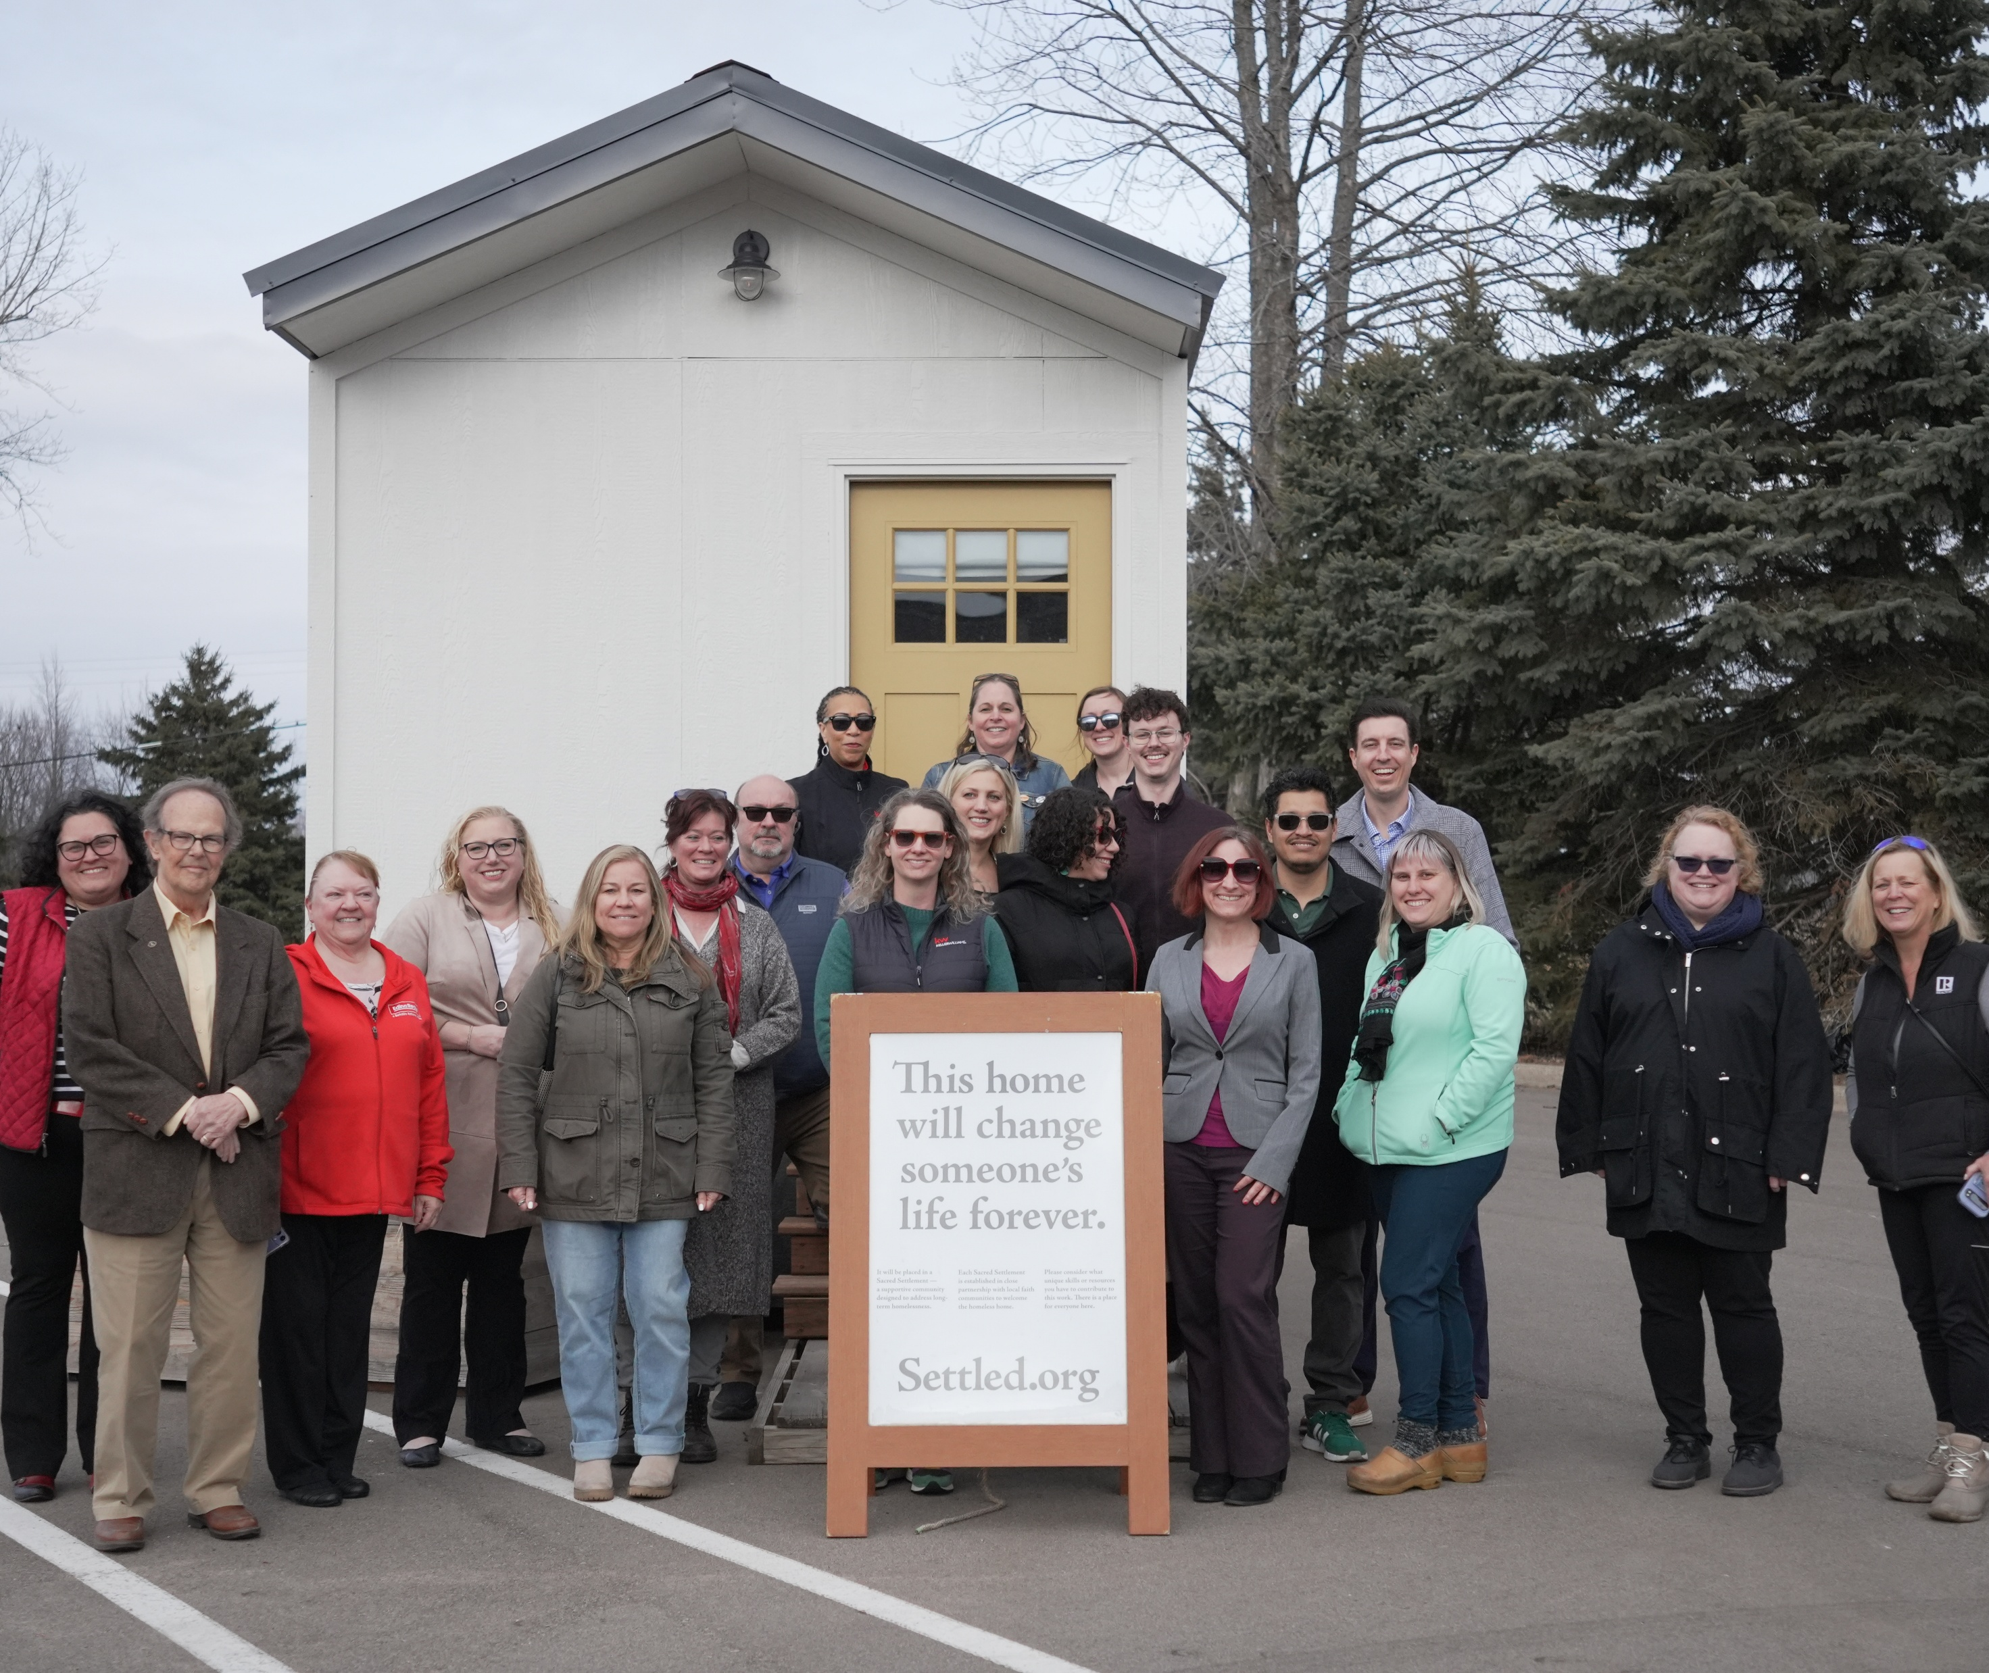

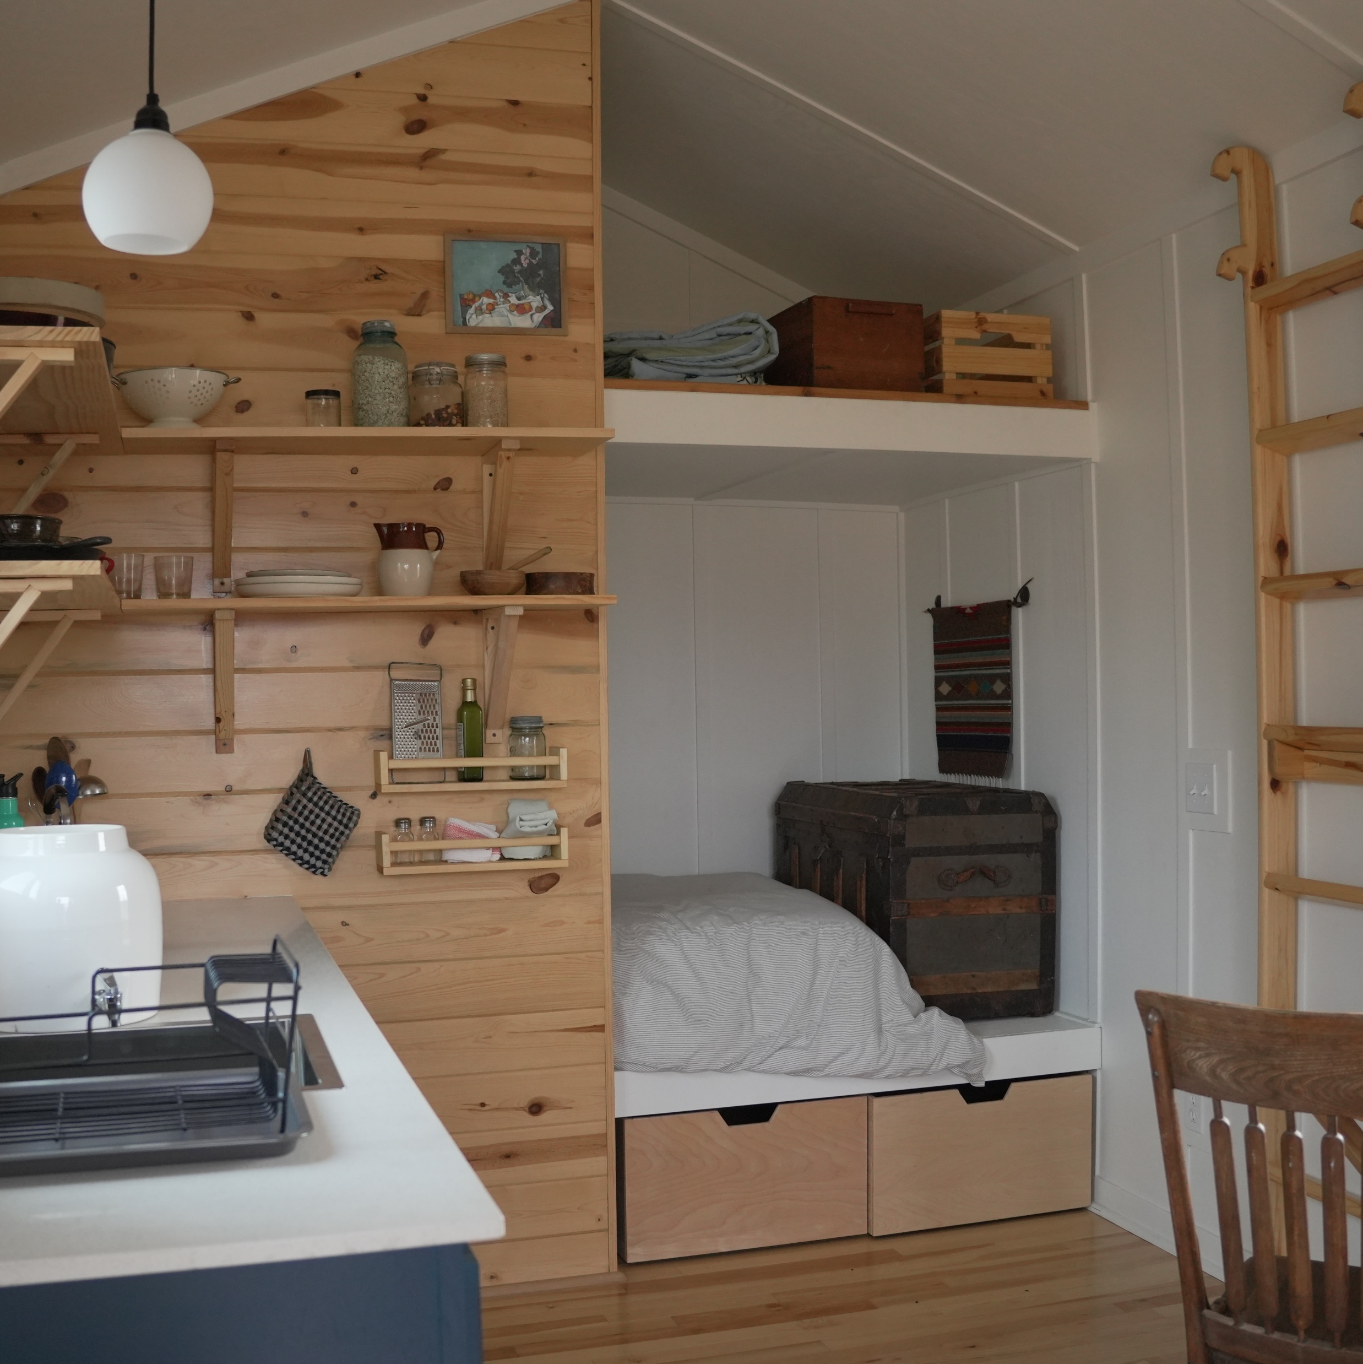
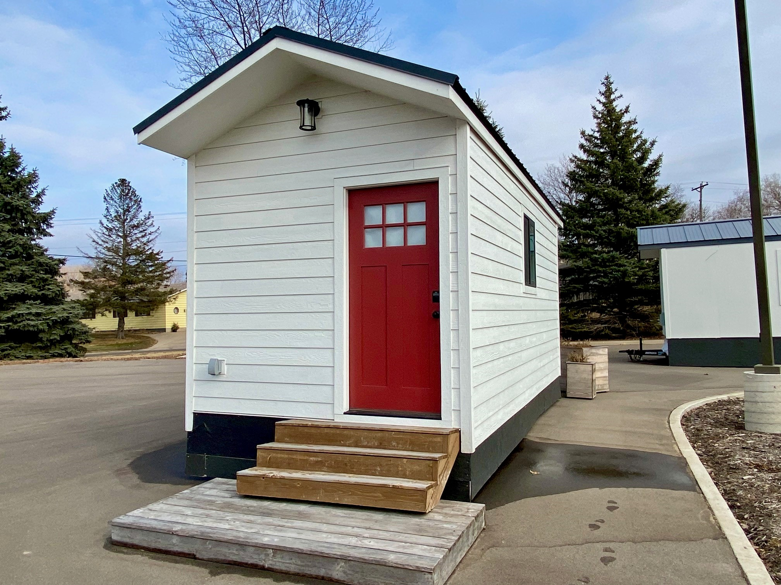
A visit to Settled
Nearly two dozen SPAAR members and staff visited Settled on March 5 to learn about the nonprofit behind Sacred Settlements, which works to house people who’ve been chronically homeless – one year or longer – by creating tiny home communities in partnership with area churches.
Learn more about Settled, including ways to volunteer or donate.

Slide 3
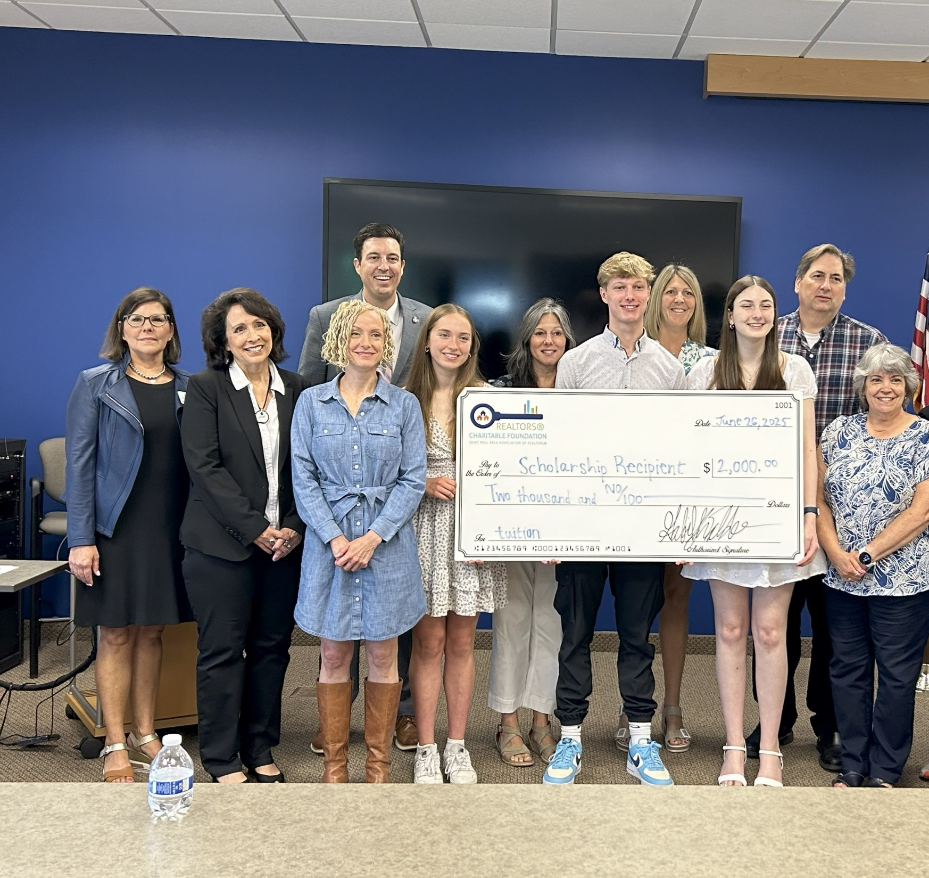
REALTORS® Charitable Foundation student scholarships are open to members’ kids and grandkids!
Apply today – deadline is March 27!
Students may apply now for the 2026 REALTORS® Charitable Foundation scholarship program. Any child(ren) or grandchild(ren) of current SPAAR members who will be entering a college, university or trade school, or continuing in their post-education journey in fall 2026, are welcome to apply for the scholarship.
Applications and supporting materials are due by Friday, March 27.

Slide 4
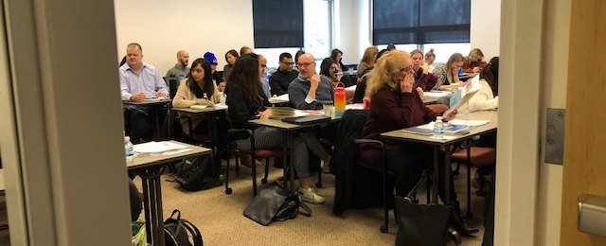
Sign up for the April dates of SPAAR’s CE Blitz
SPAAR is offering two full days of continuing education in April as part two of its CE Blitz. Participants who take part in these CE-approved classes work toward completion to meet the MN Real Estate License education requirements before the June 30 deadline. Space License education requirements befo CE Blitz -- Required Module // MN Agency + Fair Housing (Apr 29, 8:30 AM) CE Blitz -- New NORML: Marijuana & Real Estate // Home Inspection Horrors II (Apr 30, 8:30 AM)

Slide 5
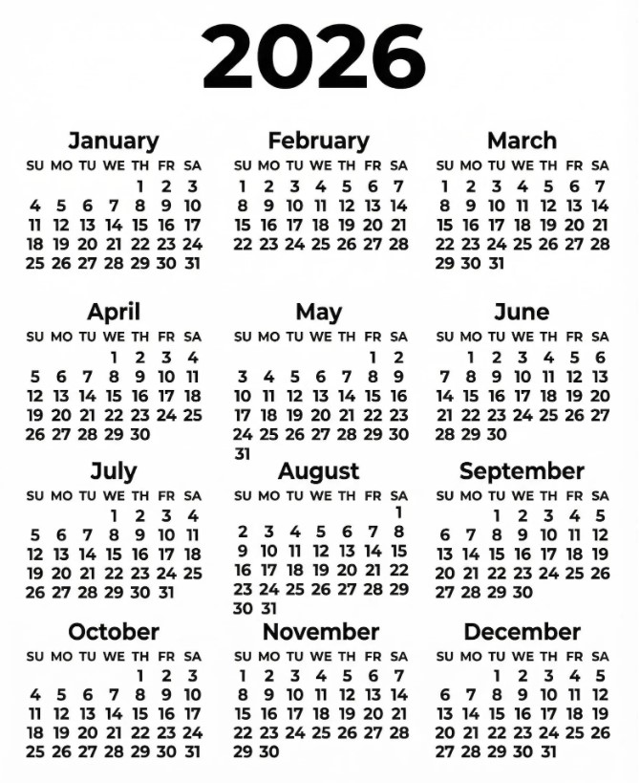
Take advantage of classes and events at SPAAR!
Check out SPAAR’s calendar to stay up to date on classes, events and more throughout 2026.
In addition to what’s offered online and in person per SPAAR’s calendar, SPAAR also offers a microlearning library with a variety of topics that cover tips, tricks and tutorials, all available to watch on video.
Email spaar@spaar.com with questions.

Slide 6



Click here to see the latest Twin Cities housing statistics
(also available on SPAAR’s website under News & Statistics).

Slide 7



Are you receiving SPAAR’s weekly newsletters?
If not, email spaar@spaar.com
to be sure you’re receiving
eNews on Mondays and Education updates on Thursdays.
Keep up to date on SPAAR information and events at www.spaar.com and on social media: Facebook, Instagram, Twitter and LinkedIn.

