Slide 1
SPAAR's Homeownership Rally returns on May 16
Come learn about services and programs that help make homeownership possible. The event will feature businesses and nonprofits with information to help real estate professionals and clients navigate the homebuying journey. This year’s event will include a focus on home maintenance and home repair programs and services.
Registered participants will receive a free lunch from American Dream Machine, hosted by SPAAR’s Committee for Diversity, Equity & Inclusion. Realtors® and clients are invited to attend.
The Homeownership Rally will take place on May 16, from 2-5pm, in SPAAR’s parking lot, weather permitting.
There is no cost to attend but registration is required for the free lunch. Register for the Homeownership Rally here. Registration will close on May 15 at 4:45pm.

Slide 2
NAHREP releases its 2025 State of Hispanic Homeownership Report
"As a Latina agent, I see firsthand how our community is driving change in real estate. With Latinos projected to make up 70% of new homeowners over the next 20 years it’s something every Realtor should be paying attention to." - Guille Garza, SPAAR Board of Directors member.
NAHREP recently released its 2025 report as a resource for members. It provides critical insights into trends, challenges and opportunities in Hispanic homeownership---a key driver of the U.S. housing market.

Slide 3
SPAAR goes on the road. Request a visit today!
It’s no secret that real estate is everchanging. The Saint Paul Area Association of REALTORS® (SPAAR) exists as a resource for members working to stay in sync, and even a step ahead, with news and information. Hearing from SPAAR members is one of the best ways to make this happen.
SPAAR CEO Gabe Walsh is kicking off a listening tour starting now to visit with members throughout SPAAR's 12-county service area.
Gabe is heading out on the road to meet as many members as possible in offices, at coffee shops or whatever is most convenient to hear members’ wants and needs and learn how SPAAR can best support the 7,500 members it serves now and in the years to come.
Take a listen to Gabe's full message here, and help determine where Gabe will visit next.

Slide 4
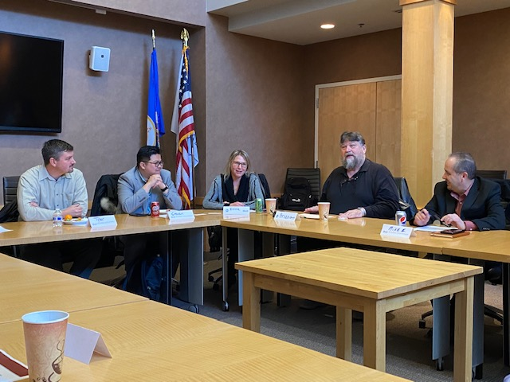
SPAAR Toastmasters is open to all Realtor® and Affiliate members
SPAAR Toastmasters is kicking off its spring season and welcomes Realtor® and Affiliate members to attend an upcoming meeting.
The meetings take place at SPAAR on the first and third Tuesdays of each month from 1-2pm.
Toastmasters provides:
Leadership skills development
Impromptu speaking opportunities
Meeting management skills
Self-paced program
Constructive evaluation
Speech development
Support from club members
Positive and fun learning environment
“Toastmasters helps keep my saw sharpened,” said Brian Beermann, a broker and an agent who has been part of various Toastmasters groups over the years. “There’s a noticeable confidence in speaking among those who practice with regularity and it’s evident when working with clients and professionals alike.”

Slide 5
Wellness sessions open to SPAAR members
SPAAR is committed to meeting members where they are at—no matter where that might be. With this in mind, SPAAR is excited to offer the Wellness Group, a unique initiative designed by members for members.
The Wellness Group is confidential space where members can openly share their experiences and challenges and build strategies to navigate the emotional rollercoaster that often comes with the real estate profession. Brokers already play a crucial role in supporting agents through these ups and downs, and SPAAR wanted to offer an additional resource—one that can be shared with agents when they need or seek even more support.
Learn more about SPAAR's Wellness Group. Email spaar@spaar.com with any questions. Register here to attend the SPAAR Wellness Group session on May 21.

Slide 6
Click here to see the latest Twin Cities housing statistics
(also available on SPAAR’s website under News & Statistics).

Slide 7
Are you receiving SPAAR’s weekly newsletters?
If not, email spaar@spaar.com
to be sure you’re receiving
eNews on Mondays and Education updates on Thursdays.
Keep up to date on SPAAR information and events at www.spaar.com and on social media: Facebook, Instagram, Twitter and LinkedIn.

