Slide 1
April is Fair Housing Month
Click here to check out the Fair Housing toolkit resources available to SPAAR members.

Slide 2
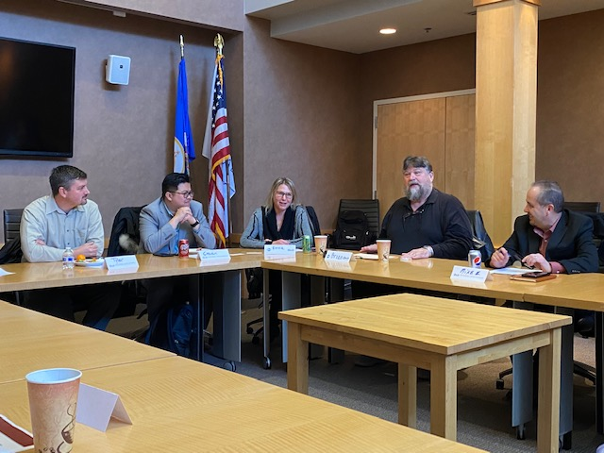
SPAAR Toastmasters is open to all Realtor® and Affiliate members
SPAAR Toastmasters is kicking off its spring season and welcomes Realtor® and Affiliate members to attend an upcoming meeting.
The meetings take place at SPAAR on the first and third Tuesdays of each month from 1-2pm.
Toastmasters provides:
Leadership skills development
Impromptu speaking opportunities
Meeting management skills
Self-paced program
Constructive evaluation
Speech development
Support from club members
Positive and fun learning environment
“Toastmasters helps keep my saw sharpened,” said Brian Beermann, a broker and an agent who has been part of various Toastmasters groups over the years. “There’s a noticeable confidence in speaking among those who practice with regularity and it’s evident when working with clients and professionals alike.”

Slide 3
Voices of Rondo: A Community Conversation
Join fellow Realtors® at Voices of Rondo: A Community Conversation, hosted by SPAAR’s Housing Book Club and Committee for Diversity, Equity and Inclusion where attendees will be able to engage with author Kate Cavett and special guests featured in the book The Voices of Rondo: Oral Histories of Saint Paul's Historic Black Community.
Register here for this engaging event taking place on Thursday, April 17.

Slide 4
Learn about human trafficking and Corrie's House at an April 10 talk at SPAAR
Take part in an eye-opening presentation on the pervasive issue of human trafficking---modern-day slavery. Learn about this issue and how it impacts some of the most vulnerable members of the community.
Learn more and register here for the presentation that will take place on April 10, from 10-11am, at SPAAR.

Slide 5
Click here to see the latest Twin Cities housing statistics
(also available on SPAAR’s website under News & Statistics).

Slide 6
Are you receiving SPAAR’s weekly newsletters?
If not, email spaar@spaar.com
to be sure you’re receiving
eNews on Mondays and Education updates on Thursdays.
Keep up to date on SPAAR information and events at www.spaar.com and on social media: Facebook, Instagram, Twitter and LinkedIn.

