Slide 1
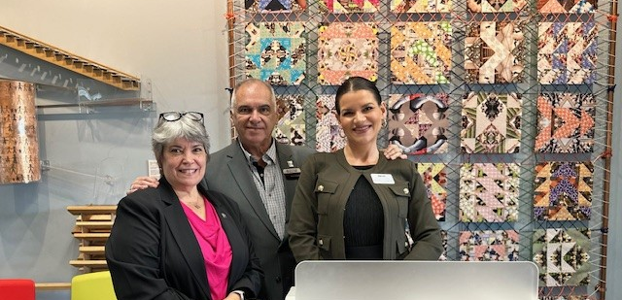
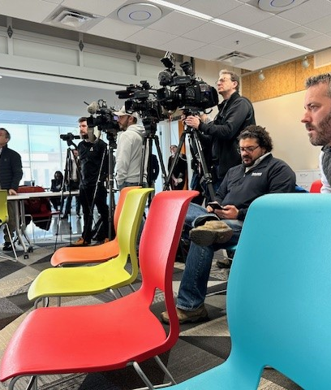
SPAAR/MAR/MNR joint annual housing market news conference
SPAAR President Jennifer Livingston; MAR President Frank D’Angelo; and Minnesota Realtors® President Patti Jo Fitzpatrick took the podium together on January 28 to address local reporters with a recap of the 2024 housing market throughout the Twin Cities and Greater Minnesota and shared predictions for 2025.
KMSP-TV, KSTP-TV, KARE-TV, Minnesota Public Radio, Pioneer Press, Axios, St. Paul Publishing (St. Paul Voice, La Voz Latina) and Finance & Commerce were the local media outlets in attendance.
Click here to see the KSTP-TV coverage, which highlights all three presidents and captures the experience of Malik Samuel, a new homeowner.

Slide 2
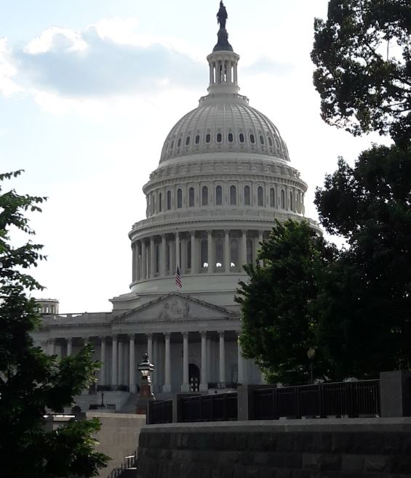
Apply now for the Emerging Leaders scholarship to attend NAR Midyear
SPAAR's Emerging Leaders scholarship program is aimed for up-and-coming SPAAR members who want future leadership positions within the Association. SPAAR will provide a $2,500 scholarship to attend the National Association of REALTORS® Legislative Meetings held in Washington DC May 31- June 5, 2025.
Those who are relatively new to their real estate career or only recently begun serving on a SPAAR committee are encouraged to apply on or before February 6. Apply Today.

Slide 3
Make SPAAR Toastmasters part of your 2025 routine

Slide 4
Send a card for Random Acts of Kindness Day
Brighten someone’s day and bring a smile to their face with your kind words and a card, and SPAAR will mail it on your behalf!
Random Acts of Kindness Day is February 17. Submit your message to SPAAR by February 9, and SPAAR will mail a card with your message and a coffee card to the recipient(s) of your choice. This day was created to spread love and positivity to create a more compassionate and caring society.
This opportunity is open to all SPAAR members.
Submit your kindness message here.

Slide 5
Fair Housing/Anti-Bias Training and Code of Ethics: what members should know
Starting in 2025, Realtors® are required to complete Fair Housing/Anti-Bias Training upon becoming a member, and every three years thereafter, coinciding with the Code of Ethics training timeline. This requirement is in addition to the Code of Ethics training. Qualified training must be not less than two hours of instructional time. The training must meet specific learning objectives and criteria established by the National Association of REALTORS®.
The current three-year compliance period for both REALTORS® Code of Ethics and Fair Housing/Anti-Bias Training is January 1, 2025 – December 31, 2027.
Find more information and approved options to meet the new Fair Housing requirement here.

Slide 6
Click here to see the latest Twin Cities housing statistics
(also available on SPAAR’s website under News & Statistics).

Slide 7
Are you receiving SPAAR’s weekly newsletters?
If not, email spaar@spaar.com
to be sure you’re receiving
eNews on Mondays and Education updates on Thursdays.
Keep up to date on SPAAR information and events at www.spaar.com and on social media: Facebook, Instagram, Twitter and LinkedIn.

