Slide 1
Check out SPAAR’s On-Demand Education Pass – 25% discount when purchased by December 31
With SPAAR’s On-Demand Education Pass, there are no preset bundles - you get to choose 10 courses of any CE length for one low price! Flexible, convenient, and designed for busy REALTORS®.
SPAAR is committed to bringing its members relevant and exciting education. 15 or more hours of new On-Demand CE will be added throughout the year!

Slide 2
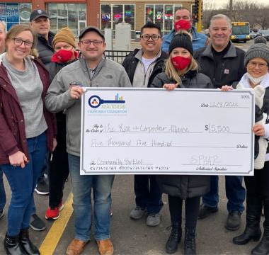
Applications now open for Key Communities grant program
SPAAR has kicked off its fifth year of the Key Communities grant program with applications now being accepted through Friday, December 20.
Key Communities is a yearlong initiative that builds strong ties between SPAAR Realtor® members and communities within SPAAR’s
12-county service area.
Three applicants will be chosen by SPAAR’s Government Affairs Committee for projects.
Prior participants have included the cities of Blaine, Burnsville, Centerville, Coon Rapids, Faribault, Farmington and St. Paul.

Slide 3
SPAAR’s next mental wellness session will take place on December 19
SPAAR has another opportunity for members to focus on their mental wellness through supportive discussions, exercises in self-awareness, and techniques to manage the roller coaster of real estate on Thursday, December 19, from 10-11am.
Realtors® strive to be resilient and compassionate professionals who are at the top of their game mentally and emotionally for their clients, yet Realtors® are also parents, caregivers, grandparents and people with lives beyond real estate, and the stressors that can come with the job. Register for the session here.

Slide 4
SPAAR is a sponsor of the King Boreas Grande Day Parade – January 25 at 2pm
SPAAR is seeking participants to be part of its parade unit for the 2025 King Boreas Grande Day Parade on Saturday, January 25, at 2pm. Families and friends of SPAAR members are welcome to join in the fun!
Interested to walk in the Grande Day Parade? Email spaar@spaar.com if interested to partake.
SPAAR wants to hear members’ Winter Carnival stories. Do you have a personal connection to this beloved Saint Paul tradition? SPAAR will share these stories on social media and in eNews. Share your story at spaar@spaar.com.

Slide 5
Click here to see the latest Twin Cities housing statistics
(also available on SPAAR’s website under News & Statistics).

Slide 6
Are you receiving SPAAR’s weekly newsletters?
If not, email spaar@spaar.com
to be sure you’re receiving
eNews on Mondays and Education updates on Thursdays.
Keep up to date on SPAAR information and events at www.spaar.com and on social media: Facebook, Instagram, Twitter and LinkedIn.

