Slide 1
Time sensitive education reminders: Code of Ethics and On-Demand Education
Before yearend 2024, SPAAR wants to make sure members are up on their Code of Ethics status and are aware of its limited offer for a price-reduced On-Demand Education Pass.
All Realtors® must have completed an approved Code of Ethics course between January 1, 2022, and December 31, 2024. Check your COE compliance status today. If you took COE from another provider, be sure to report that to SPAAR.
SPAAR's On-Demand Education Pass is on sale for a limited time. This pass provides an opportunity to bundle preferred courses for one low cost. Learn more and purchase an On-Demand Education Pass.

Slide 2
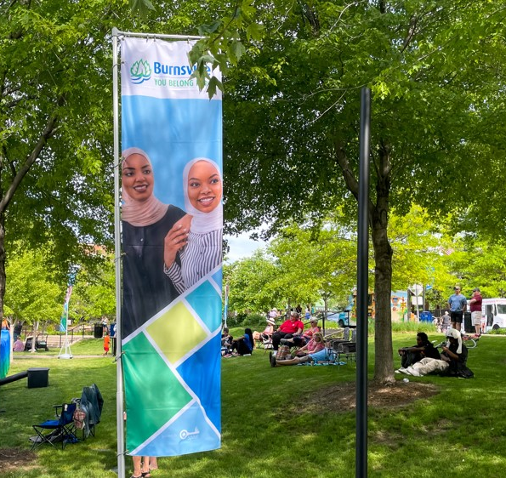
Applications now open for Key Communities grant program
SPAAR has kicked off its fifth year of the Key Communities grant program with applications now being accepted through Friday, December 13.
Key Communities is a yearlong initiative that builds strong ties between SPAAR Realtor® members and communities within SPAAR’s
12-county service area.
Three applicants will be chosen by SPAAR’s Government Affairs Committee for projects.
Prior participants have included the cities of Blaine, Burnsville, Centerville, Coon Rapids, Faribault, Farmington and St. Paul.

Slide 3
SPAAR’s next mental wellness session will take place on December 19
SPAAR has another opportunity for members to focus on their mental wellness through supportive discussions, exercises in self-awareness, and techniques to manage the roller coaster of real estate on Thursday, December 19, from 10-11am.
Realtors® strive to be resilient and compassionate professionals who are at the top of their game mentally and emotionally for their clients, yet Realtors® are also parents, caregivers, grandparents and people with lives beyond real estate, and the stressors that can come with the job. Register for the session here.

Slide 4
Add SPAAR Toastmasters to your calendar for the new year
SPAAR Toastmasters welcomes those who are interested in mastering their communication and leadership skills.
SPAAR Toastmasters meetings take place at SPAAR on the first and third Tuesdays of each month from 1-2pm.
Toastmasters provides:
Impromptu speaking opportunities
Meeting management skills
Self-paced program
Constructive evaluation
Positive and fun learning environment
Toastmasters operates clubs worldwide to promote communication and public speaking skills and SPAAR Toastmasters has existed since 2019.
Updates are noted on SPAAR's calendar.

Slide 5
Click here to see the latest Twin Cities housing statistics
(also available on SPAAR’s website under News & Statistics).

Slide 6
Are you receiving SPAAR’s weekly newsletters?
If not, email spaar@spaar.com
to be sure you’re receiving
eNews on Mondays and Education updates on Thursdays.
Keep up to date on SPAAR information and events at www.spaar.com and on social media: Facebook, Instagram, Twitter and LinkedIn.

