Slide 1
Member Vote: Notice of Action by Written Ballot of Members
Pursuant to Articles XII(11) and XVI of the Bylaws of the Saint Paul Area Association of REALTORS® (“SPAAR”), you are entitled to cast votes on the following proposed Amendments to the SPAAR Bylaws.
Click here to read the full Notice of Action by Written Ballot of Members.

Slide 2
Informational sessions offered prior to the vote!
SPAAR will be holding informational sessions prior to the vote so members can learn more about the proposed changes. See the dates and times below to register.
Managing Broker Only Sessions:
August 8, 9:30 – 10:30 AM at the SPAAR Office (No Virtual Option to Attend)
August 8, 2:00 – 3:00 PM – Zoom Meeting (No In Person Option to Attend)
All SPAAR Member Sessions:
August 13, 9:30 – 10:30 AM – Zoom Meeting (No In Person Option to Attend)
August 13, 2:00 – 3:00 PM – at the SPAAR Office (No Virtual Option to Attend)

Slide 3
MLS participation without REALTOR® membership FAQ
All Saint Paul Area Association of REALTORS® (SPAAR) members who are REALTORS® will have the opportunity to vote on changes within SPAAR’s bylaws. This vote will occur August 14-16. You can read all the proposed changes HERE. One of the proposed changes will allow MLS participation for those who are not REALTORS®.
Click here to read the full MLS participation without REALTOR® membership FAQ.
Additional questions? Submit any additional questions to bylaws@spaar.com for consideration to be answered at the upcoming informational sessions and in future SPAAR communications.

Slide 4
Tech Dump returns to SPAAR on August 9
SPAAR members are welcome to bring their old electronics to recycle and enjoy a breakfast bag to-go as a 'thank you' for stopping by.
This event is free and open to all SPAAR members.

Slide 5
Volunteers sought for candidate interviews
SPAAR has begun its 2024 candidate endorsement process, and the advocacy team is looking for volunteers to take part in the candidate interviews that will occur mid-September.
Contact SPAAR’s government affairs directors Becky Wegscheid or Simon Opatz with questions or to volunteer. No experience is required.

Slide 6
Take part in the social mixer tour
Hope to see you there!
Tipsy Steer
2704 Snelling Ave, Roseville, MN 55113

Slide 7
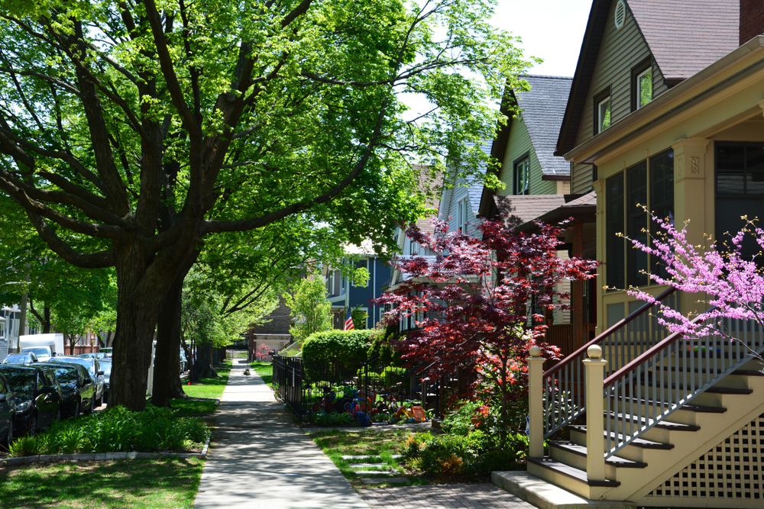
Click here to see the latest Twin Cities housing statistics
(also available on SPAAR’s website under News & Statistics).

Slide 8
Are you receiving SPAAR’s weekly newsletters?
If not, email spaar@spaar.com
to be sure you’re receiving
eNews on Mondays and Education updates on Thursdays.
Keep up to date on SPAAR information and events at www.spaar.com and on social media: Facebook, Instagram, Twitter and LinkedIn.

