Slide 1
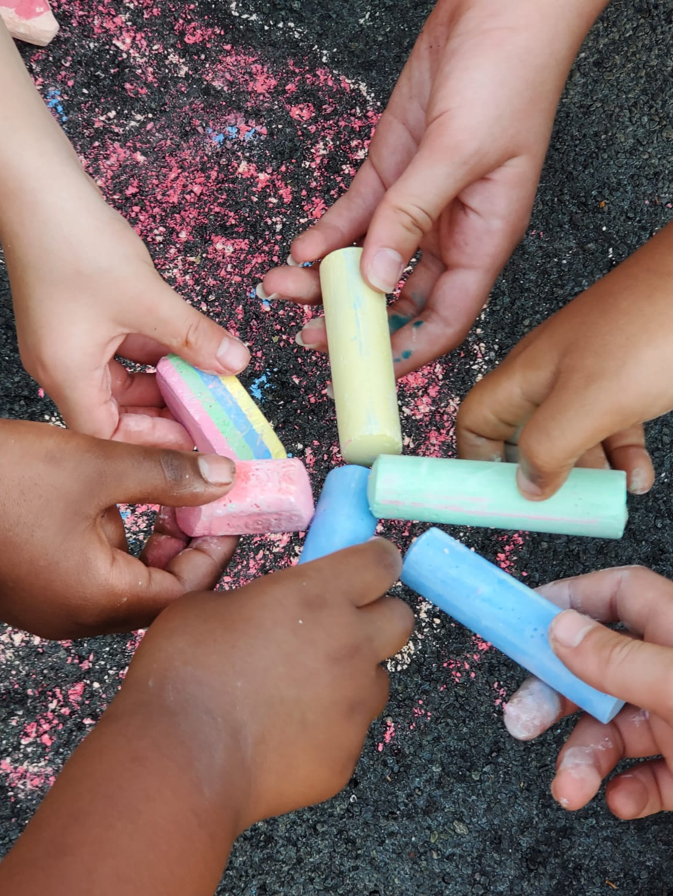
National Night Out is August 6
Are you a National Night Out (NNO) block captain? Do you contribute to your neighborhood's party?
SPAAR is again supplying Cub Foods gift cards and cases of water to support SPAAR member NNO events. Advance registration is required and available while supplies last.
Email spaar@spaar.com to sign up for the NNO items.

Slide 2
Save the date: the SPAAR-B-Q is July 23
Connect, mingle and enjoy (a free) lunch with fellow SPAAR members at this year's SPAAR-B-Q, the ultimate networking cookout taking place on July 23 from 11am to 1pm at SPAAR. Come hungry! There will be a hot dog bar with all the fixings, chips and dessert. Register for the SPAAR-B-Q here.

Slide 3
Value of a Realtor® videos highlight all that Realtors® do every day
Realtors® bring great value to clients and communities every day; however, sometimes all the things Realtors® do aren’t obvious, so SPAAR created a series of short videos, featuring SPAAR member volunteers that highlight the significant impact and numerous activities Realtors® do. The value of a Realtor® is real. Thank you, SPAAR members! Check out the most recent video here.

Slide 4
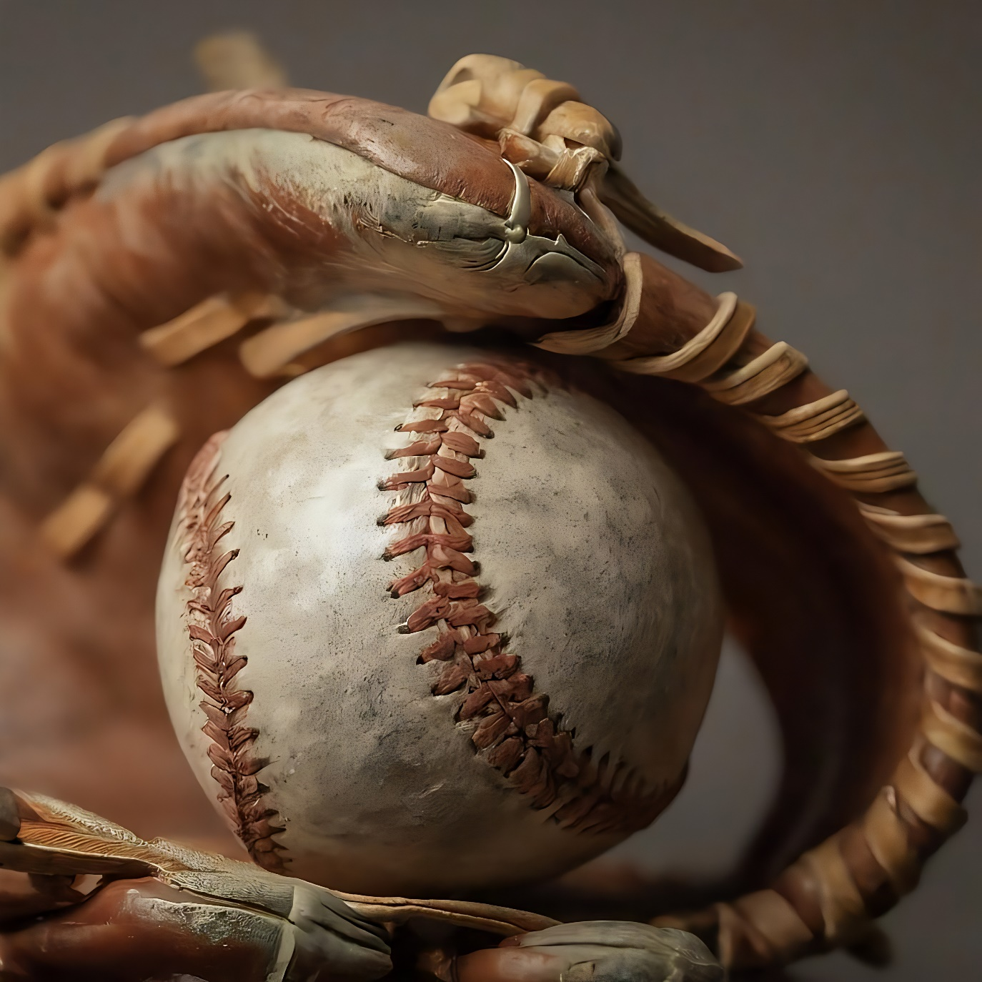
SPAAR members + networking + Saints baseball = the perfect summer evening!
Are you ready for a night of fun, food and fantastic networking? Join your fellow SPAAR members for a pre-game meal and networking on August 22 from 5:30-7pm. Game start is at 7:07pm. Enjoy the excitement of a live baseball game. Cheer on the Saint Paul Saints with colleagues, friends and family for a memorable evening of baseball fun!
Ticket Information: • Cost: $10 per person (includes pre-game meal) • Additional tickets are available for children or guests
Order tickets here.

Slide 5
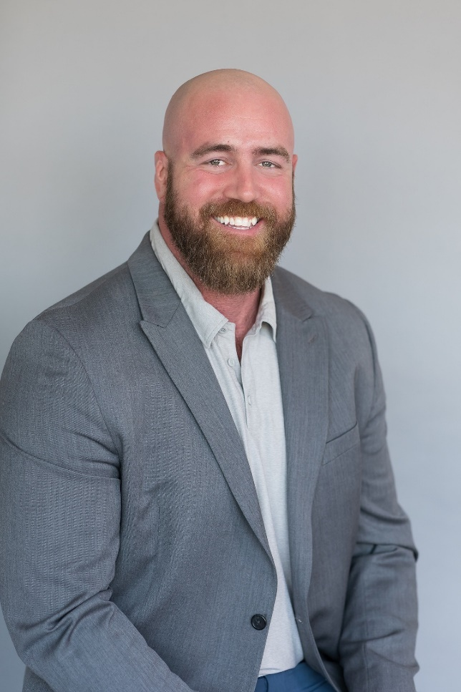
Grant Thompson has been named SPAAR Hero!
Grant worked for years as an MRI technician in the radiology field and at a medical device company helping to develop and implement MRI technology. Then came Covid. Fast forward to the summer of 2021; Grant completed the necessary coursework, became a Realtor® and joined The Korby Home Team with Keller Williams Integrity Realty.
Grant was recognized for his volunteer work with Hope Kids Minnesota, which provides events, activities and support for families who have a child with cancer or a life-threatening medical condition. He combines his interests in volunteering for Hope Kids and participating in Relentless Minnesota where strongman participants raise money by lifting insane amounts of weight in honor of the most fragile who cannot. Read the full article about Grant Thompson’s SPAAR Hero honor here. Congratulations, Grant!
Know someone who should be a SPAAR Hero? Send an email to spaar@spaar.com.

Slide 6
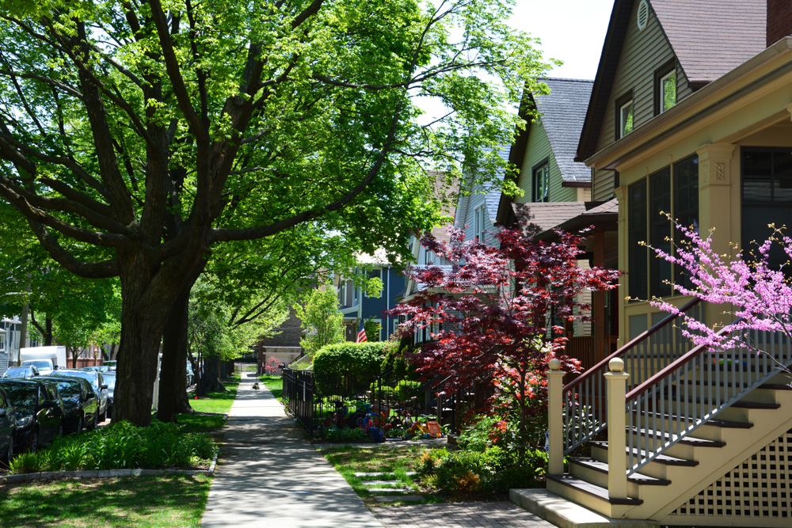
Click here to see the latest Twin Cities housing statistics
(also available on SPAAR’s website under News & Statistics).

Slide 7
Are you receiving SPAAR’s weekly newsletters?
If not, email spaar@spaar.com
to be sure you’re receiving
eNews on Mondays and Education updates on Thursdays.
Keep up to date on SPAAR information and events at www.spaar.com and on social media: Facebook, Instagram, Twitter and LinkedIn.

