Slide 1
Have coffee with SPAAR’s President on Thursday, May 2
SPAAR members are invited to enjoy a coffee with SPAAR's 2024 President, Amy Peterson. The no-agenda coffee stop is a way for members to connect with SPAAR's Leadership to talk about whatever is on their minds.
On May 2, Amy will be at:
Coffee Corner in Princeton from 9-11am
(207 S Rum River Drive), and
Edge Bar + Boutique Coffee Shop in Elk River from
1-3pm (609 Main Street).
Read eNews for additional dates and locations.
Any questions or interest to connect directly with Amy Peterson, feel free to contact her at amy@realtoramy.com.

Slide 2
Join fellow SPAAR members are in a meal-packing competition at Meals from the Heart in Oak Park Heights on Thursday, May 16, to support local food shelves. SPAAR members will go to head-to-head with teams from area businesses, competing for bragging rights. Each SPAAR team will consist of 7-10 volunteers to work one-hour shifts at 10:30am, 2pm and 6:30pm. Contact Joe at jmckinley@spaar.com to learn more and sign up.
Volunteer for meal packing on May 16 to support local food shelves

Slide 3
SPAAR is hosting a homeownership rally!
This member event will provide the opportunity to learn about helpful resources for clients. It will include information on Downpayment Assistance, Home Stretch and Minnesota's new First Gen programs and more, including networking with other real estate professionals. A food truck will be onsite for lunch.
The free event for SPAAR members takes place on Friday, May 17, from 11am to 2pm at SPAAR. Register to attend today: Homeownership Rally! (ramcoams.net)

Slide 4
SPAAR’s Housing Affordability Task Force donated $10,000 to Habitat for Humanity in 2023. These funds went directly toward helping a family in need to purchase a home in Roseville’s Community Land Trust. Habitat for Humanity will host a celebration highlighting SPAAR’s donation, the family that the donation helped to house, and other similar stories on Saturday, May 18, from 11am to 2pm at the Harrison Recreation Center in Minneapolis, and SPAAR members are welcome to attend. Click here to learn more and register for this free, family-friendly event.
Habitat for Humanity’s Spring 2024 Home Celebration is open to SPAAR members

Slide 5
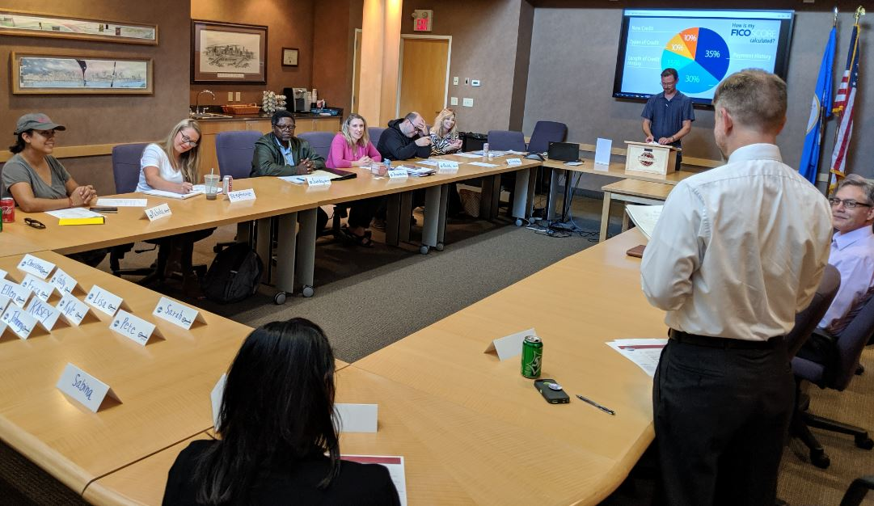
SPAAR Toastmasters: an open house invitation for May 21!
SPAAR members are welcome to attend the SPAAR Toastmasters open house on Tuesday, May 21, from 12:30 to 2pm.
Arrive at 12:30pm for networking and light refreshments.
Stay from 1-2pm for Toastmasters. No experience is necessary.
SPAAR Toastmasters provides the space for members who seek:
to grow in confidence in their public speaking
the ability to practice on a regular basis in front of an audience, and
to gain leadership skills in the process.
Interested to attend the open house?
RSVP by emailing Jennifer at jkovacich@spaar.com.

Slide 6
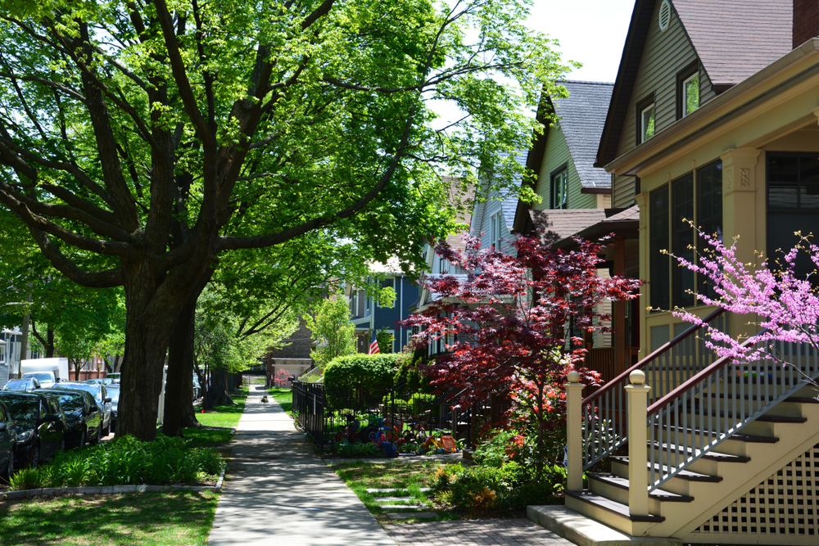
Click here to see the latest Twin Cities housing statistics
(also available on SPAAR’s website under News & Statistics).

Slide 7
Are you receiving SPAAR’s weekly newsletters?
If not, email spaar@spaar.com
to be sure you’re receiving
eNews on Mondays and Education updates on Thursdays.
Keep up to date on SPAAR information and events at www.spaar.com and on social media: Facebook, Instagram, Twitter and LinkedIn.

