Slide 1
SPAAR introduces its new Q&A feature for members
SPAAR's Word on the Street is a way to introduce timely topics within the real estate industry and hear what members have to say through poll and open-ended questions. The feature will run twice a month.
Check out the current question here.

Slide 2
SPAAR is hosting a homeownership rally!
This member event will provide the opportunity to learn about helpful resources for clients. It will include information on Downpayment Assistance, Home Stretch and Minnesota's new First Gen programs and more, including networking with other real estate professionals. A food truck will be onsite for lunch.
The free event for SPAAR members takes place on Friday, May 17, from 11am to 2pm at SPAAR. Register to attend today: Homeownership Rally! (ramcoams.net)

Slide 3
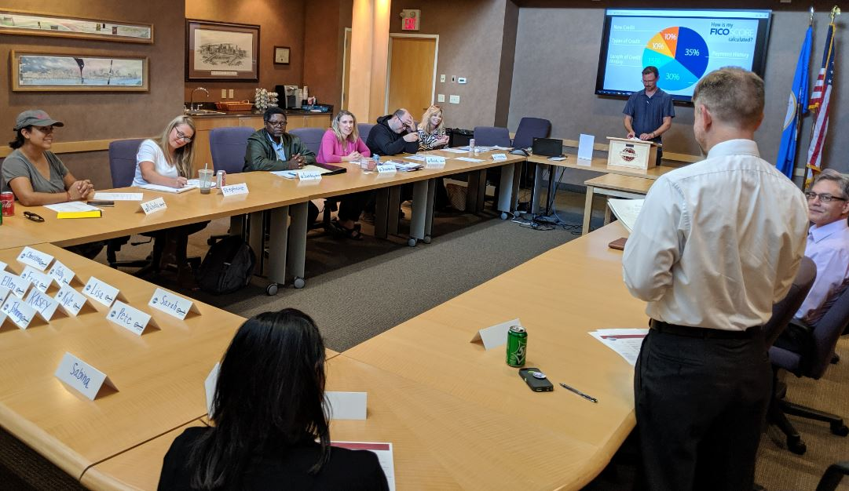
SPAAR Toastmasters: an open house invitation for May 21!
SPAAR members are welcome to attend the SPAAR Toastmasters open house on Tuesday, May 21, from 12:30 to 2pm.
Arrive at 12:30pm for networking and light refreshments.
Stay from 1-2pm for Toastmasters. No experience is necessary.
SPAAR Toastmasters provides the space for members who seek:
to grow in confidence in their public speaking
the ability to practice on a regular basis in front of an audience, and
to gain leadership skills in the process.
Interested to attend the open house?
RSVP by emailing Jennifer at jkovacich@spaar.com.

Slide 4
SPAAR members are invited to enjoy in the Coffee with the President visits taking place throughout SPAAR’s service area. The no-agenda coffee outings are a way for members to connect and converse with SPAAR’s 2024 President, Amy Peterson. The remainder of the dates are as follows: Anoka at Avant Garden at 215 E Main Street in Anoka from 1pm-3pm on April 24. Mille Lacs from 9-11am and Sherburne County from 1-3pm on May 2 Washington County from 9-11am on May 15 Chisago County from 9-11am and Isanti County from 1-3pm on May 29 Ramsey County from 9-11am on May 30 Stay tuned to SPAAR’s eNews on Mondays for more information about the exact locations. Any questions or interest to connect directly with Amy Peterson, feel free to contact her at amy@realtoramy.com.

Slide 5
SPAAR’s On-Demand library is growing
SPAAR’s newest courses now include topics on appraisals, digital marketing, inspections, pricing strategies and shoreline real estate.
The complete On-Demand catalog of available courses can be found at spaar.com/on-demand. Click on each individual course title to expand for course details and to register. Or, use the CE-hour filter buttons to search for courses by CE hours.

Slide 6
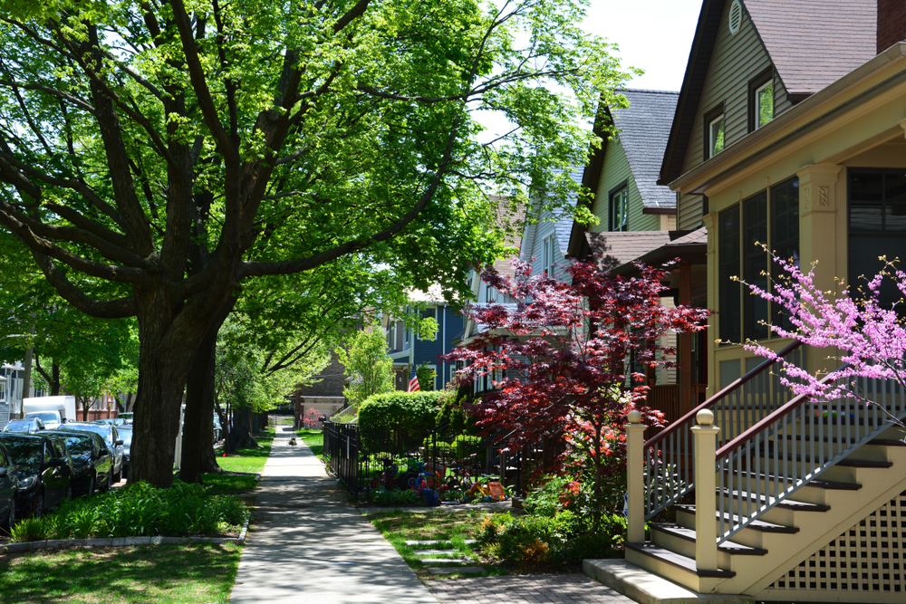
Click here to see the latest Twin Cities housing statistics
(also available on SPAAR’s website under News & Statistics).

Slide 7
Are you receiving SPAAR’s weekly newsletters?
If not, email spaar@spaar.com
to be sure you’re receiving
eNews on Mondays and Education updates on Thursdays.
Keep up to date on SPAAR information and events at www.spaar.com and on social media: Facebook, Instagram, Twitter and LinkedIn.

