Slide 1
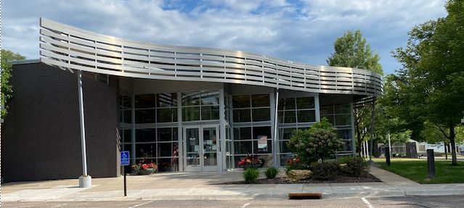
Invite your clients to SPAAR’s Nonprofit Fair on September 27
Mark your calendar to join SPAAR for its first-ever Nonprofit Fair to meet and connect with local housing-related nonprofits.
Attendees will learn about the impactful work of each nonprofits as well as the valuable resources and programs they offer for Realtors®, clients and fellow community members.
Participating organizations include Dakota County; Minnesota Housing Partnership; Neighborhood Development Alliance; Neighborhood House; Northwest Home Partners; Ramsey County; Second Harvest Heartland; Solid Ground; The Homeownership Center; Twin Cities Habitat for Humanity; Twin Cities YIMBY; and Washington County.
SPAAR's Nonprofit Fair will take place on
Wednesday, September 27, from 2-4pm
at SPAAR (325 Roselawn Avenue East).
All are welcome!

Slide 2
SPAAR’s Fall Book Club starts in October
Starting on Thursday, October 5, at 8am via Zoom, and every Thursday through October, SPAAR will host its virtual book club to discuss Golden Gates: Fighting for Housing in America.
New York Times journalist Conor Dougherty chronicles America's housing crisis from its West Coast epicenter, peeling back the decades of history and economic forces to where things are today.
To participate, contact SPAAR Government Affairs Director Simon Opatz at simonopatz@gmail.com.

Slide 3
Take a swing for a great cause! Support REALTORS® Charitable Foundation at Topgolf on October 24
The REALTORS® Charitable Foundation is hosting its Topgolf fundraising event for its second year. All SPAAR members are welcome to participate as golfers or caddies (spectators).
Come to play, socialize, support the Foundation and enjoy an afternoon of refreshments. Get your tickets here for the Topgolf fundraiser.
For some added fun, attendees are encouraged to show some spirit and dress to impress in your best Halloween Costume! Prizes will be awarded for Best Team, Worst Team and Best Costume.

Slide 4
Leadership SPAAR application process now open for its 2024 program.
Leadership SPAAR is designed to empower emerging Realtor® leaders and guide them in maximizing their leadership potential. The year-long commitment provides participants the opportunity to gain insights and experience in advocacy, community engagement, media training and business etiquette, to name a few of the program’s many opportunities.
Interested SPAAR members should apply here. The deadline to apply for 2024 Leadership SPAAR program is November 3, 2023.

Slide 5
Click here to see the latest Twin Cities housing statistics
(also available on SPAAR’s website under News & Statistics).

Slide 6
Are you receiving SPAAR’s weekly newsletters?
If not, email spaar@spaar.com
to be sure you’re receiving
eNews on Mondays and Education updates on Thursdays.
Keep up to date on SPAAR information and events at www.spaar.com and on social media: Facebook, Instagram, Twitter and LinkedIn.

