Slide 1

march 2023
Check out SPAAR’s calendar to learn more about the education opportunities available as well as upcoming events.

Slide 2
MetroCLT invites Realtors® to learn, mix and mingle event
SPAAR members are invited to join leaders of metro-based community land trusts for a learning and networking opportunity on Tuesday, March 28, from 3:30-5:30pm at Habitat for Humanity.
The event will feature a short presentation about the basics of the land trust model and the important role Realtors® can play in matching low to moderate income individuals and families to homeownership. Following the presentation, there will be a chance to network and answer any questions. Beer, wine and light refreshments will be provided.
REGISTER HERE to attend the MetroCLT event.

Slide 3

SPAAR Social Mixer tour stop: Blaine on April 6
Learn more and register here.

Slide 4
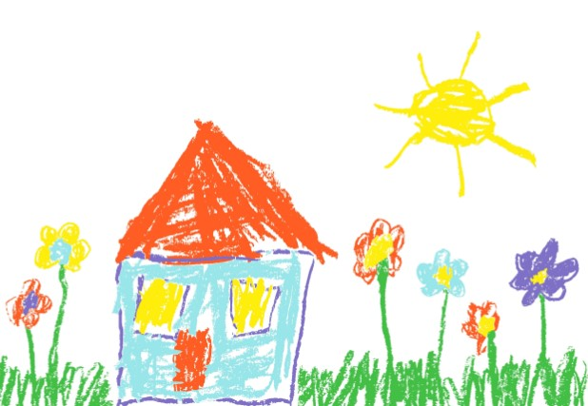
Extra! Extra! The Fair Housing coloring contest is back!
The 2023 Fair Housing coloring contest is now open! This is a great way to connect with clients of all ages, and everyone who enters is eligible to win a $25 gift card, as winners are selected from four different age categories.
Please read the contest rules here and share with anyone who might like to participate.
This contest is a great way to learn about Fair Housing and the importance of equal housing opportunities for everyone.
The coloring contest is open through April 11. Physical coloring pages are also available at SPAAR.
Questions? Email spaar@spaar.com.

Slide 5


2024 NAR Committee applications are now open
Apply now to be on a 2024 National Association of REALTORS® (NAR) committee and be at the helm of shaping NAR's destiny. Applications are now open through Monday, May 15.
﻿Click here to learn more about the 2024 NAR committees and how to apply.

Slide 6


Click here to see the latest Twin Cities housing statistics
(also available on SPAAR’s website under News & Statistics).

Slide 7



Are you receiving SPAAR’s weekly newsletters?
If not, email spaar@spaar.com to be sure you’re receiving
eNews on Mondays and Education & Events on Thursdays.
Keep up to date on SPAAR information and events at www.spaar.com and on social media: Facebook, Instagram, Twitter and LinkedIn.

