Slide 1

NOVEMber 2022
Check out SPAAR’s calendar to learn more about the education opportunities available as well as upcoming events.

Slide 2


Congratulations to recent SPAAR Heroes!
Congratulations to the newest SPAAR Heroes: Tom Bullington and Karen Stang for the volunteerism they bring to their respective communities!
SPAAR Hero was created to recognize a SPAAR member or member team for their community involvement and to shine a light on the many good things Realtors® are doing in the community every day.
SPAAR is always seeking SPAAR Hero nominations.
Email Joe at jmckinley@spaar.com to nominate a future SPAAR Hero.

Slide 3
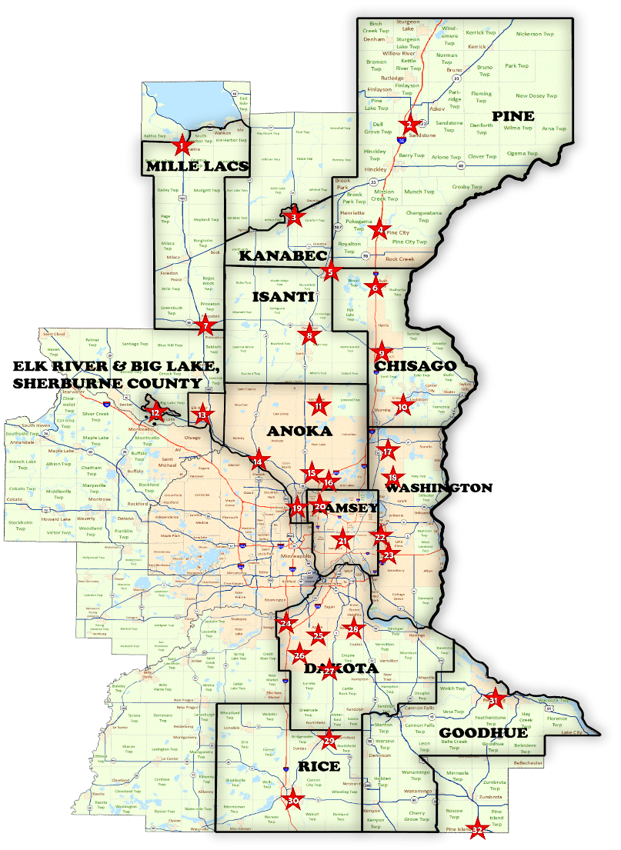
#ThanksGivingBack – on a great roll!
When SPAAR Realtors® and Affiliates were asked to help fill a need to get toilet paper to dozens of food shelves, the challenge was on, and it's going strong! The TP throne in SPAAR's lobby is growing every day as the toilet paper collection continues through November.
SPAAR is on a roll for this year's #ThanksGivingBack to collect 8,100 rolls of toilet paper, one roll for every SPAAR member, to be donated to food shelves within SPAAR's 12-county service area.
Donations are still welcome through the end of this week, with distribution to the 30+ food shelves in early December.

Slide 4

SPAAR Toastmasters open house on December 6
All SPAAR members are welcome to attend the SPAAR Toastmasters open house where participants will have the opportunity to network and participate in a meeting. SPAAR Toastmasters is a great way to polish up those speaking skills and learn leadership skills in the process.
﻿The SPAAR Toastmasters open house will take place on Tuesday, December 6, from 12:30 to 2:30pm.
Interested in attending? RSVP to Jennifer at jkovacich@spaar.com.

Slide 5


Click here to see the latest Twin Cities housing statistics
(also available on SPAAR’s website under News & Statistics).

Slide 6



Are you receiving SPAAR’s weekly newsletters?
If not, email spaar@spaar.com to be sure you’re receiving
eNews on Mondays and Education & Events on Thursdays.
Keep up to date on SPAAR information and events at www.spaar.com and on social media: Facebook, Instagram, Twitter and LinkedIn.

