Slide 1

September 2022
Check out SPAAR’s calendar to learn more about the education opportunities available as well as upcoming events.

Slide 2

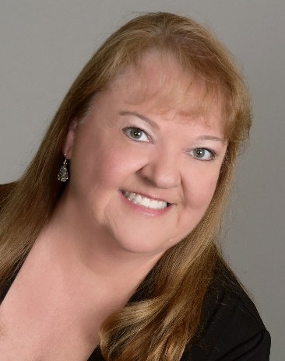

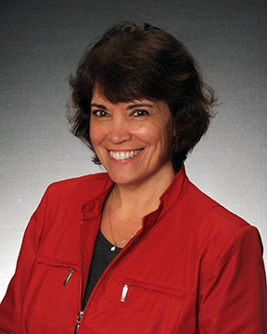
SPAAR members honored at Minnesota Unite
SPAAR is pleased to announce the honors earned by three of its members at Minnesota Unite, the Minnesota Realtors® annual state convention held on September 21-22, 2022.
Congratulations to Man Huynh who was awarded the 2022 Ed Anderson Political Achievement award, which honors a member for outstanding contributions in politics and public policy, both locally and nationally. Man serves as the 2022 president of SPAAR’s REALTORS® Charitable Foundation.
Congratulations to Amy Peterson who was named 2022 Realtor® of the Year, an annual honor that recognizes a member whose outstanding work advanced their state association, and the entire Minnesota real estate industry. Amy is also the 2022 president-elect for SPAAR’s Board of Directors and a member of SPAAR’s REALTORS® Charitable Foundation.
Congratulations to Patti Jo Fitzpatrick who has been named the 2023 First Vice President for Minnesota Realtors®. The First Vice President is a new role for 2023 as part of the all-volunteer leadership team. She is currently the secretary/treasurer for SPAAR’s REALTORS® Charitable Foundation.

Slide 3
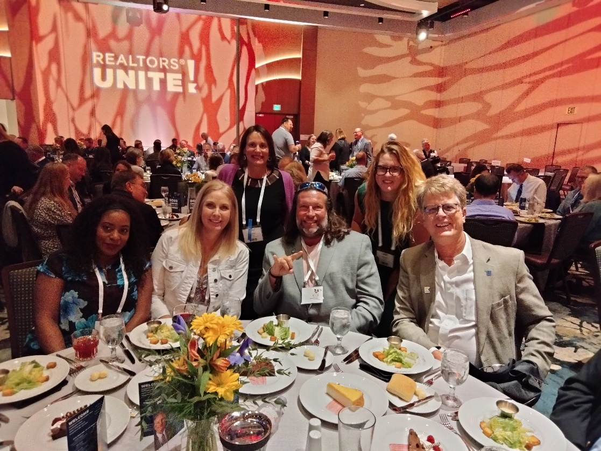
Take the next step as an industry leader with Leadership SPAAR
Today’s emerging leaders will shape the real estate industry and guide SPAAR into the future. Leadership SPAAR is designed to identify emerging Realtor® leaders and empower them to maximize their leadership potential. Apply here to be a part of the 2023 Leadership SPAAR; applications are due by Friday, November 4.

Slide 4


You’re invited to SPAAR Connect on October 12
Interested to learn how you can get involved at SPAAR? Joining a committee is a great way to do so!
SPAAR offers opportunities on any of the following committees:
Affiliate. Committee for DEI. Communications. Community Engagement. Government Affairs. Metro YPN. Professionalism.
Being part of the Realtor® community at SPAAR allows you to take part in the ideas and decisions made at SPAAR that impact all members.
SPAAR Connect is Wednesday, October 12, from 11am to 1pm at SPAAR.
325 Roselawn Avenue East
St. Paul

Slide 5

REALTORS® Charitable Foundation supports local nonprofits
SPAAR’s REALTORS® Charitable Foundation on behalf of area Realtors® is pleased to announce this year’s grant recipients: Great River Greening, Project for Pride in Living and The Sanneh Foundation to receive a combined $100,000.
Great River Greening will use its $25,000 grant to restore an urban green space as part of the Frogtown Park Restoration Project.
Project for Pride in Living, Inc., will use its $25,000 grant for home-ready education programs specifically held to counsel individuals within the SPAAR service area.
The Sanneh Foundation will use its $50,000 grant to support housing initiatives in the SPAAR service area.

Slide 6


Click here to see the latest Twin Cities housing statistics
(also available on SPAAR’s website under News & Statistics).

Slide 7



Are you receiving SPAAR’s weekly newsletters?
If not, email spaar@spaar.com to be sure you’re receiving
eNews on Mondays and Education & Events on Thursdays.
Keep up to date on SPAAR information and events at www.spaar.com and on social media: Facebook, Instagram, Twitter and LinkedIn.

